Slide 1

Head Start A to Z, 2.0
Technology and Information Systems
Notes:
Slide 1
Facilitator Notes:
Welcome participants to the session and introduce yourself. If you have co-facilitators, invite them to introduce themselves, too. Begin the session with an introductory activity to create a positive group climate and begin the engagement process.
Prepare for the activity by setting out picture cards that illustrate a range of possible feelings about technology. Prepare to have at least one card per participant, and preferably more. As participants enter the room, ask them to choose the card that best expresses their own feelings about technology. If you do not have picture cards, ask participants to fill in the blank in the following sentence: “When I think about technology, I” They can write their responses on scrap paper or flipchart sheets hung around the room.
When participants have finished choosing their cards or completing the fill-in-the-blank exercise, tell them you’ll return to the activity in a few minutes. Then, introduce the session by reviewing the following material.
Say to Participants: “The National Center on Program Management and Fiscal Operations has updated Head Start A to Z to align with the revised Head Start Program Performance Standards that became effective in November 2016. Head Start A to Z was originally designed to support new leaders in their Head Start roles. The term ‘leaders’ ensures that anyone at the management level, or in some cases the governing body, Tribal Council, or Policy Council level, can attend the sessions or use the materials for independent learning.
“The updated Head Start A to Z, 2.0, learning modules provide baseline-level information primarily through a leadership and management systems lens. The presentations are modeled on ‘learning organization’ concepts. In each of the modules, we recognize key characteristics of learning organizations, including a supportive learning environment, openness to new ideas, and time dedicated for reflection.
“Each attendee has an important role to play in the success of this session. Those with experience remind us where we’ve come from and what we must do to maintain our identity and uniqueness. New members bring a fresh perspective and remind us what we must do to prepare for the future. All roles are essential for Head Start to be a learning organization that continues to grow and flourish.
“Head Start A to Z, 2.0, is most successful when it helps us share the best of what we have to offer with a strength-based focus. As you engage in this session, we hope that you will support one another in the learning process by generously sharing your knowledge, experience, and perspective.”
Now, revisit the opening activity. If you used picture cards, ask volunteers to describe why they chose the particular cards they did. If participants wrote fill-in-the-blank responses, ask a few to read and explain their answers.

Slide 2
Learning Objectives
As a result of this session, participants will:
Learn why technology and information systems are critical to Head Start programs
Understand how technology and information systems are linked to the other Head Start management systems
Explore the many ways Head Start leaders use technology
Identify strategies for integrating technology throughout your program
Notes:
Slide 2
Facilitator Notes:
Distribute the Reflective Practice Tool handout.
Say to Participants: “In this session, participants will:
Learn how technology and information systems are relevant to Head Start operations
Understand how technology and information systems are linked to the other Head Start management systems
Explore the many ways Head Start leaders use technology
Identify strategies for integrating technology and information systems throughout your Head Start program”
Guide participants to the Reflective Practice Tool handout.
Say to Participants: “At the end of our session, you will be asked to use this Reflective Practice Tool to write down some key thoughts based on what you’ve learned. We encourage you to jot down preliminary ideas as we move through the presentation.”

Slide 3
Six Guiding Principles for A to Z Trainings
1
3
5
Successful programs are learning organizations.
Sound decision-making is informed by quality data.
Relationship-building is at
the heart of transformational leadership.
2
4
6
The effective delivery of services grows out of strong systems.
School readiness for all is our driving goal.
Culturally and linguistically diverse organizations rely on intentional, specific, and coordinated approaches.
Notes:
Slide 3
Facilitator Notes:
Distribute the Head Start A to Z Guiding Principles handout.
Say to Participants: “Head Start A to Z, 2.0, is based on six guiding principles. These guiding principles are foundational to the design of the modules and have been aligned with the HSPPS.
“Head Start directors and managers come from all walks of life with a wealth of employment experiences. However, we all share a commitment to a comprehensive, high-quality early childhood experience. We recognize that, to promote school readiness and be responsive to the needs of our communities, we must engage in ongoing professional development. Head Start A to Z, 2.0, was created to support professional growth and development for Head Start leaders.”
Guide participants to the Head Start A to Z Guiding Principles handout. Review the six principles below. You may paraphrase or slightly summarize.
Successful programs are learning organizations. Head Start is a dynamic organization with high expectations, values, and traditions. Programs are constantly responding to changing community needs and evolving best practices. To cultivate a learning organization that thrives in this environment, program leaders must support all staff in becoming life-long learners who embrace challenges as opportunities for collective problem-solving and innovation.
The effective delivery of services grows out of strong systems. Program leaders must regularly refine their program’s management and fiscal systems. To target community needs and deliver comprehensive services, leaders need to understand systems thinking and view their program through a systems lens. They also need to recognize the relationship between systems, services, and child and family outcomes.
Sound decision-making is informed by quality data. Used in planning, evaluating, and communicating information, quality data is integral to cultivating a culture of continuous quality improvement. To this end, it is critical for leaders to establish efficient processes for collecting, aggregating, analyzing, and synthesizing data. This involves training teachers, home visitors, family advocates, health services workers, and other staff how to integrate data management into their day-to-day work.
Relationship-building is at the heart of transformational leadership. Robust Head Start communities build on authentic relationships between all of their stakeholders, from children, families, staff, and managers to governing bodies, Tribal Councils, and Policy Councils. To cultivate these communities, leaders need to communicate effectively, empower others, foster team-building, and nurture collaboration.
School readiness for all is our driving goal. Head Start leaders play an integral role in conceiving and promoting an inclusive vision of school readiness. To support children with diverse abilities and backgrounds to develop the skills, knowledge, and attitudes needed to be successful in school, effective leaders must stay informed on developments in early childhood education. They also must actively collaborate with parents, staff, governing bodies, local education agencies, and community partners in embedding these best practices into services and programming.
Culturally and linguistically diverse organizations rely on intentional, specific, and coordinated approaches. To ensure the full and effective participation of dual language learners and their families, Head Start leaders must coordinate program-wide plans that involve all service areas and multiple staff. This includes staying connected to the communities served, implementing targeted strategies, and articulating how programs and services address specific linguistic and cultural needs.
Say to Participants: “In addition to anchoring the content in Head Start A to Z, 2.0, you will revisit these guiding principles in all of the trainings offered by PMFO.”

Slide 4
A Day in the Life – Scenario 1
Notes:
Slide 4
Facilitator Notes:
Distribute the Technology: A Day in the Life – Scenario 1 handout.
Say to Participants: “Read the scenario in this handout, then work with your tablemates for 10 minutes to answer the questions at the bottom.”
After 10 minutes, call the group back together. Point out that this scenario is an example of how leaders rely on fiscal staff to support their work.
Then, read each question below and ask for volunteers to share their table’s answer. Continue until each question has been addressed, writing responses on a flipchart.
How is Tess using technology to carry out her work responsibilities and support program activities?
What other ways could she use technology?
Does this differ from how your program uses technology? In what ways?
How could you improve the use of technology in your program?
Now, discuss other ways of working with technology. Ask participants how technology could help:
Assess the school readiness of children
Establish education metrics home visitors can use in household settings
Manage the use of bus monitors
Track outcomes of family service workers
Record answers on flipchart paper.

Slide 5
Defining Terms
Technology uses science to develop useful tools to solve problems.
Information systems are software that help you organize and analyze data. This makes it possible to answer questions and solve problems relevant to the mission of an organization.
Notes:
Slide 5
Facilitator Notes:
Introduce terms and definitions related to technology and information systems.
Say to Participants: “Technology and information systems store and manage Head Start and Early Head Start data. They also support other management systems. Let’s review the definitions on the slide.”
Read the definitions aloud, or ask a participant to do so. Point out that, according to these definitions, technology solves problems by inventing helpful tools. Information systems collect, store, and analyze data, converting it into useful information that informs decision-making.

Slide 6
Defining Terms
Hardware: Technology you can physically touch.
Software: A set of instructions a computer uses to perform specific operations.
Information technology (IT):
The use of computers to store, retrieve, transmit, and manipulate information, often in the context of a business or other enterprise.
Notes:
Slide 6
Facilitator Notes:
Continue introducing terms and definitions.
Say to Participants: “Here are a few more terms you should know.”
Read each definition aloud or ask volunteers to read them. Ask participants to identify examples of each term. Make sure the following examples are mentioned:
Hardware includes laptops, tablets, smartphones, and telephone systems
Software includes fiscal and program management software, e-learning platforms, apps, and social media sites
Information technology includes servers and networks

Slide 7
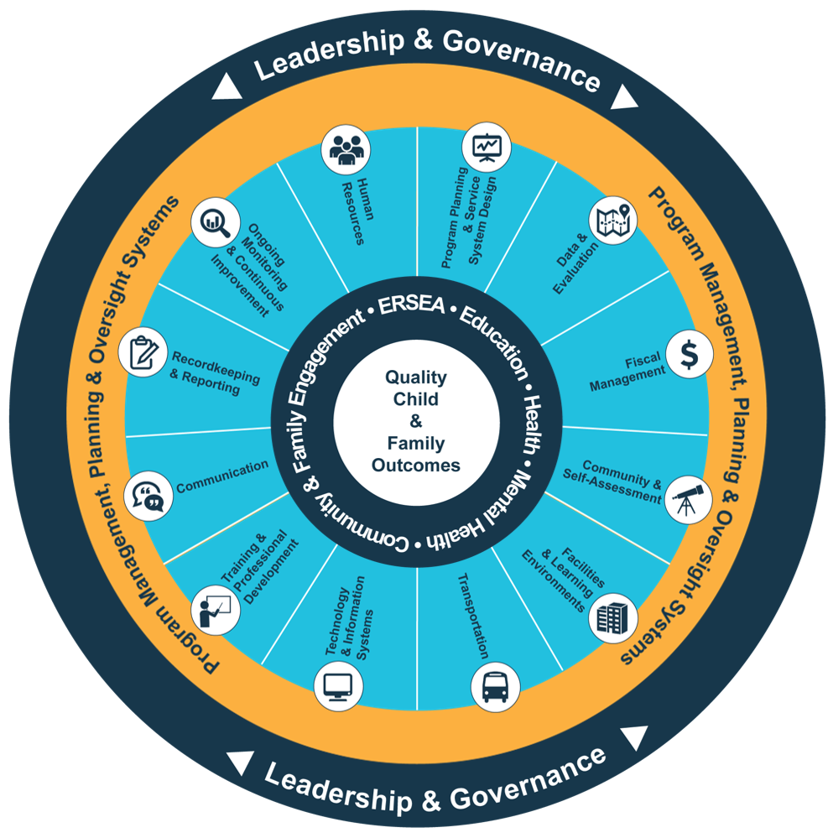
Head Start Management Systems Wheel
Five-Year Project Period
Notes:
Slide 7
Facilitator Notes:
Deliver the following material as a mini-lecture.
Say to Participants: “The Head Start Management Systems Wheel can help us understand how technology and information systems fit into the overall picture.”
In your own words, explain the graphic on the slide by pointing to its various elements and describing each, basing your descriptions on the bullet points below.
The dark blue outer circle includes the functions of leadership and governance. They are the bedrocks of effective management, encompassing and informing the 12 management systems.
The yellow circle outlines the scope of these systems.
The segmented aqua blue ring outlines each of the 12 management systems. These systems work together to inform and influence the program’s service delivery. These services include education, health, mental health, community partnerships, family engagement, and eligibility, recruitment, selection, enrollment, and attendance (ERSEA).
Say to Participants: “You see that one of the aqua blue wedges is labeled ‘technology and information systems.’ That’s the management system we’re looking at in this session. In Head Start programs, all of these systems work together to inform and influence the program’s service delivery, which you see in the dark blue inner circle. When innovative leadership, strong management systems, and well-designed services are working together, we produce quality child and family outcomes.”

Slide 8

Technology and Information Systems
Maintain the infrastructure needed to address increased reliance on data collection and analysis.
Select and manage the appropriate hardware and software needed to monitor progress.
Achieving program goals, 45 CFR §1302.102(c)
Establishing procedures, 45 CFR §1303.20
Maintaining records, 45 CFR §1303.24(b)
Program procedures - applicable confidentiality provisions, 45 CFR §1303.21
Notes:
Slide 8
Facilitator Notes:
Direct participants’ attention to the slide.
Say to Participants: “As you see on the slide, technology and information systems is one of the 12 management systems. It underscores the importance of maintaining a physical infrastructure that supports data collection and analysis. This infrastructure includes hardware and software. These tools enable organizations to track inputs and outputs and monitor their progress.”

Slide 9
Technology and Information Systems in the HSPPS
45 CFR §1302.101 – Automated accounting and recordkeeping system; coordinated approaches
for data management
45 CFR §1302.102(c) – Data for continuous improvement
45 CFR §1303.20 – Establishing procedures for personally identifiable information (PII)
45 CFR §1303.24(b) – Maintaining records for PII
45 CFR §1303.21 – Applicable confidentiality provisions around PII
Notes:
Slide 9
Facilitator Notes:
Call participants’ attention to the slide.
Say to Participants: “The HSPPS say programs must:
Maintain an automated accounting and recordkeeping system
Use coordinated approaches to data management
Use data to identify program strengths and establish plans addressing program needs
Establish procedures to protect children’s PII
Abide by confidentiality provisions

Slide 10

Impact on Quality Child and Family Outcomes
Technology and information systems is like a tree:
Rooted in services
Connects and strengthens systems through effective data management
Central pillar of the ecosystem that supports quality child and family outcomes
Notes:
Slide 10
Facilitator Notes:
The following activity requires participants to have Internet access.
Say to Participants: “The importance of technology and information systems in Head Start and Early Head Start programs can’t be overstated. Given its role in managing and storing data, it is central to the proper functioning of all the other management systems.
“To visualize its role, think about this system as a tree—the technolotree—that is rooted in our services to children and families. It also connects Head Start systems to make them stronger. Technology acts as a central support for our programs as we pursue quality child and family outcomes.
“If we use technology strategically, the other systems become more efficient and effective. Let’s think more about this impact.
“We looked at the Head Start Management Systems Wheel on a previous slide. I’d like each of you to turn to a partner and find the wheel on one of your devices—a smartphone, tablet, or laptop. Go to the Early Childhood Learning and Knowledge Center (ECLKC) website and search for ‘management wheel.’ Once you’ve found it, brainstorm ways technology impacts the other 11 management systems. Take notes so you can share your thoughts with the group. You’ll have 10 minutes for this activity.”
After 10 minutes, ask volunteers to share ideas from their conversations. Responses may include:
Program monitoring software helps us determine how well we are meeting our goals. This impacts several management systems, including community and self-assessment, and program planning and service system design.
Budget management software allows us to document our expenditures and overall budget performance. This impacts the fiscal management system.
Software helps us manage and track many aspects of program operations, such as student attendance and school readiness.
As you can see, each of these activities contributes to our goal of creating high-quality outcomes for children and families.

Slide 11

Four Management Systems
Facilities and
learning environments
Training and
professional development
Fiscal
management
Human
resources
Notes:
Slide 11
Facilitator’s Notes:
Continue with your mini-lecture on how technology and information systems impact other management systems.
Say to Participants: “When we’re designing our technology and information systems, four of the other management systems deserve special consideration: fiscal management; facilities and learning environments; human resources; and training and professional development. To some extent, each of them determine what kind of technology we can have and how well we’ll use it. Let’s look at them one by one.
Fiscal management. Technology can be expensive, and some expenses are ongoing. Its costs are usually distributed across budget categories, meaning budgeting correctly for technology can be complicated. Fiscal management is related to technology and information systems in another important way. Fiscal staff are particularly close collaborators with program leaders, using sophisticated software to produce many of the reports that leaders rely upon.
Facilities and learning environments. You must have the physical infrastructure to securely house your technology and information systems. Your system must be protected in case of a physical breach (e.g., break-in), natural disaster, or fire. It must also be protected against a virtual breach, such as computer viruses or hacking. As technology evolves, threats to it evolve as well, and programs must continually reassess their ability to safeguard their technology.
Human resources. Technology only benefits your program if you have staff who understand it, embrace it, and use it. You can maximize your staff’s use of technology by hiring experienced IT staff and onboarding all new staff carefully.
Training and professional development. Not all staff are comfortable with technology, so leaders must try to bring everyone on board through a variety of formal and informal learning opportunities. They should consider peer-to-peer mentoring, pairing more-experienced with less-experienced staff, and bringing in volunteers who give extra support to staff who need it. Leaders should also make sure they have the ongoing IT support all programs need.

Slide 12
Attending to Our Digital Infrastructure
"When you consider the degree to which our organizations are now dependent on digital data and infrastructure, it becomes incumbent upon nonprofits ... to attend to these resources with the same integrity to mission that they manage financial and human resources."
Source: Bernholz, L. "Digital Literacy: A Core Capacity for 21st Century Nonprofits." Digital Impact (June 26, 2017). Retrieved from https://digitalimpact.io/digital-literacy-a-core-capacity-for-21st-century-nonprofits/
Notes:
Slide 12
Facilitator Notes:
Begin this section on building staff capacity by asking a volunteer to read the quote on the slide: “When you consider the degree to which our organizations are now dependent on digital data and infrastructure, it becomes incumbent upon nonprofits… to attend to these resources with the same integrity to mission that they manage financial and human resources.”
Say to Participants: “This means we have to recognize that technology and information systems are not only important because they track and analyze program data, but because they are a structural resource that is fundamentally necessary to our programs. We must use these resources effectively, ethically, and safely in order to protect our clients and our organizational health.”
Source: Bernholz, L. “Digital Literacy: A Core Capacity for 21st Century Nonprofits” Digital Impact, June 26, 2017. Retrieved from https://digitalimpact.io/digital-literacy-a-core-capacity-for-21st-century-nonprofits/

Slide 13
Raising Comfort Levels and Building Buy-In
Digital readiness:
    Concrete skills
    Trust in reliability of online information and your ability to protect your personal information
    Actual use of technology
Notes:
Slide 13
Facilitator notes:
Call participants’ attention to the slide.
Say to Participants: “As technological tools become standard in our workplace ecosystems, we need to plan for them carefully and constantly improve our ability to use them. Adopting technology without understanding your staff’s current skill levels can lead to uneven use of these tools.
“One way of understanding staff comfort and skill level is by assessing digital readiness. Pew Research Center defines digital readiness as our:
Concrete digital skills
Trust in reliability of online information and your ability to protect PII
Actual use of technology
“By determining our staff’s current level of readiness, we can set benchmarks for growth and effectively communicate expectations. When staff know what we expect and are supported in improving their skills, they are far more likely to embrace the technology and use it effectively.”
Source: Horrigan, J. “Digital Readiness Gaps.” Pew Research Center, Sept. 20, 2016. Retrieved from https://www.pewinternet.org/2016/09/20/digital-readiness-gaps/.

Slide 14
Assessing Digital Readiness
How confident are you in using computers
to perform job-related tasks?
How often do you actually use computers
or other electronic devices to complete
work tasks?
Can you determine if online information
is trustworthy?
Can you protect your own personal information online?
Adapted from Horrigan, J. “Digital Readiness Gaps.” Pew Research Center (Sept. 20, 2016). Retrieved from https://www.pewinternet.org/2016/09/20/digital-readiness-gaps/.
Notes:
Slide 14
Facilitator Notes:
Call participants’ attention to the slide.
Say to Participants: “Picking up on Pew’s definition of digital readiness, ask yourself these questions:
How confident are you using computers to perform job-related tasks?
How often do you actually use computers or other electronic devices to complete work tasks?
Do you have the capacity to determine if online information is trustworthy?
Do you feel you can protect your own personal information online?”
Ask participants to turn to their neighbor and discuss their answers. After two minutes, ask for volunteers to share some of the responses.
Then, ask participants if they thought the questions were an effective way to measure their own digital readiness. If not, what questions would be more effective?

Slide 15
Homework (Optional)
Create your own simple digital readiness assessment tool!
Email it to the presenter at @email
Notes:
Slide 15
Facilitator Notes:
Participants may complete the exercise below on paper or on their electronic devices. Decide if you want to provide your email address for the exercise described below. If so, add it to the slide where indicated. If not, eliminate the exercise.
Say to Participants: “Now, I’d like each of you to spend 10 minutes creating a simple digital readiness assessment tool for your program. By ‘tool,’ I mean a series of questions you think will yield useful information about how comfortable staff in your program feel using the various types of technology they encounter in the workplace.
“You may create your tool on paper or electronically. When you’re finished, email it to me at the address you see on the slide; after this session, I’ll email it to all of today’s participants. Feel free to team up with one other person if you are from the same program.”
After 10 minutes, ask participants to share their tools with tablemates.
Say to Participants: “Explain why you included the questions you did, and what you would do with the answers. For example, would you aggregate the data? Why or why not? Each person should take about two minutes.”
When the groups have finished, facilitate a large group discussion. Ask:
What did you like or notice about the tools your tablemates designed?
How would you improve your own tool based on what you learned from your discussion?

Slide 16
Assessing Staff Software Skills
Notes:
Slide 16
Facilitator Notes:
Distribute the Software Skills Assessment Example handout.
Say to Participants: “Tools for assessing digital readiness can be either general or specific to particular types of hardware or software. On the handout, you see an example of a tool that assesses staff skills using software programs common in Head Start programs.”
Ask participants to take two minutes to review the assessment.
Say to Participants: “Take this back to your program. It might help you create a similar skills assessment for your staff. Note that a questionnaire like this could be a fillable PDF, which means it would be available online and staff could fill it out electronically. Fillable PDFs are user-friendly but do not allow the survey authors to aggregate and analyze data. If you want to easily analyze findings, consider creating the tool in Google, Survey Monkey, or similar platforms.”

Slide 17
Key Responsibilities
Notes:
Slide 17
Facilitator Notes:
Distribute the Technology and Information Systems: Know, Do, and Oversee handout.
Say to Participants: “This handout helps leaders break down tasks related to technology and information systems into three parts:
What you need to know
What you need to do
What you need to oversee
Say to Participants: “Take five minutes to review the handout. Check tasks that you personally have performed in the past, either individually or as a member of team.”
After five minutes, ask participants to turn to a neighbor and share what they checked. Ask participants how they think they can learn more about tasks they’re unfamiliar with.

Slide 18
A Day in the Life – Scenario 2
Getting ready for the meeting
Notes:
Slide 18
Facilitator Notes:
Distribute the Technology: A Day in the Life – Scenario 2 handout.
Say to Participants: “Now, we’re going to read another scenario involving the use of technology and information systems in a program. I’d like each of you to take three minutes to read the scenario. Then, turn to a neighbor and discuss the questions on the bottom of the handout.”
After five minutes, pull the group back together. Go through the questions below one by one.
How is Tess using technology to carry out her work responsibilities and support program activities?
What other ways could she use technology?
Does this differ from how your program uses technology? In what ways?
How could you improve the use of technology in your program?

Slide 19
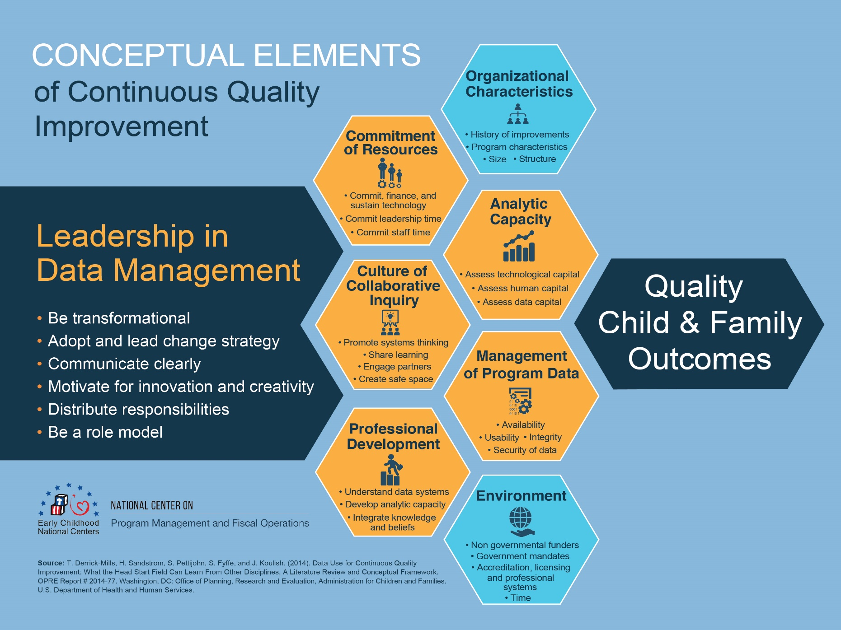
Technology and Continuous Improvement
Notes:
Slide 19
Facilitator Notes:
Distribute the Conceptual Elements of Continuous Quality Improvement handout.
Say to Participants: “We have gone through two scenarios describing everyday situations involving technology and information systems. Each scenario features an executive director who draws on this management system for the data she needs to do her job: to plan program activities, create budgets, and communicate with partners. The scenarios underscore how critical technology is to our daily work.
The system is also vital to your program’s ability to improve outcomes over time.” Point out the “analytic capacity” section on the slide.
Say to Participants: “Since the technology and information system is so important, let’s think for a moment about how we can strengthen our program’s capacity to use data for maximum benefit.”

Slide 20
Building Analytic Capacity
Data capital • Technological capital • Human capital
Notes:
Slide 20
Facilitator Notes:
Call participants’ attention to the slide.
Say to Participants: “In and of itself, data has no value. What makes it valuable is the careful way we collect and analyze it. We call this our ‘analytic capacity.’ Analytic capacity consists of three elements:
Appropriate data, known as data capital
Appropriate technology, known as technological capital
Staff capacity, known as human capital
“To develop strong analytic capacity, you must ensure you have the software and hardware you need to collect, sort, aggregate, analyze, and securely store data. That’s technological capital. But analytic capacity also involves collecting the kind of data that can yield meaningful insights, and making sure your staff know how to use data to improve program quality.”

Slide 21
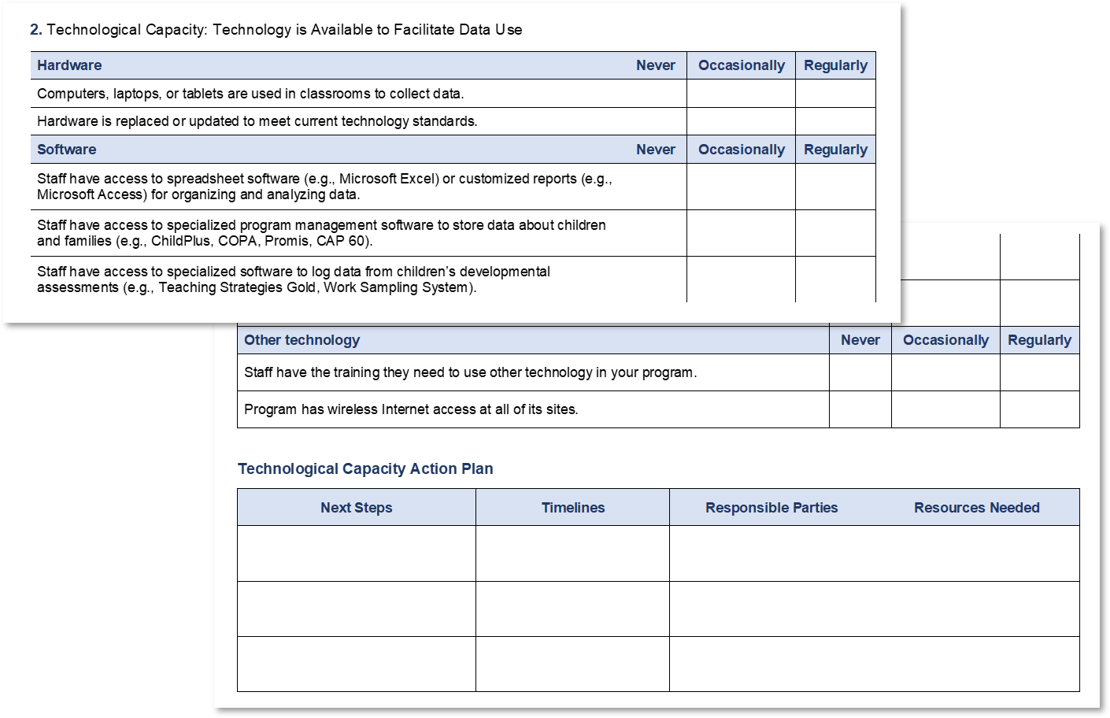
Assessing Analytic Capacity
Notes:
Slide 21
Facilitator Notes:
Distribute the Assessing Analytic Capacity handout.
Say to Participants: “This handout breaks down the three elements of analytic capacity we just mentioned. Form a group with your tablemates and spend seven minutes going through this assessment. Don’t fill it out; just read and reflect on the practices in each of the three categories.”
After seven minutes, bring the whole group back together. Ask volunteers to share which practices their programs are strongest in and which they could improve upon.
Say to Participants: “Take this assessment back to your program and complete it as a team. You’ll find it a valuable tool for improving your analytic capacity.”

Slide 22
What is a Budget?
A budget is a
  "numerical expression of an organization’s dreams that serves as a guide or measure of acceptable financial performance."
  – Financial Management for Non-Profit Organizations
Notes:
Slide 22
Facilitator Notes:
Begin this section on budgeting for technology.
Say to Participants: “Budgeting for technology and information systems isn’t necessarily straightforward. Maintaining, upgrading, or replacing technology can be expensive, and costs associated with technology appear across budget categories.
“You should plan for technology and information systems costs by:
Assessing your current technology needs
Developing a technology maintenance and replacement plan
Determining how to budget for costs across the lifespan of your technology”

Slide 23
Data-informed Budgeting
Analyze historical expense data
Project
changes, increases,
and additions
Align with program goals
Notes:
Slide 23
Facilitator Notes:
Call participants’ attention to the slide.
Say to Participants: “Your technology and information systems should allow you to conduct fiscal monitoring, reporting, forecasting, and budget development. It should also allow you to align budgeting with program goals.
“As you begin budgeting for technology, determine whether the hardware and software you have right now does everything you need it to do. For example, does your software:
Allow for historical data review?
Provide accurate and adequate financial reporting?
Provide financial forecasting?
Track program operations such as attendance and enrollment?
Track progress towards school readiness and family engagement goals?
Document the status of HR functions such as criminal record background checks or staff progress toward professional development goals?
“You also need to consider how your program may change in the near future. Do you expect increased enrollment, extended service hours, or facility renovations? What implications will those changes have on your technology and information systems?”

Slide 24
The Importance of Technology in Budget Planning
How can you anticipate equipment and technology replacement and ensure costs are properly reflected in the budget?
What do you do when a piece of technology needs immediate replacement?
What is the plan for addressing any gaps or budget shortages?
Notes:
Slide 24
Facilitator Notes:
Distribute the Assets and Equipment Maintenance and Replacement Schedule Sample handout.
Say to Participants: “When your program is creating its yearly budget, remember to anticipate any significant equipment or technology replacements that may be necessary. You may not be able to plan for every contingency. However, if you know how old your current technology infrastructure is and how long each component should last, you can estimate when it will need to be replaced or upgraded.
“Take a look at the handout. On it, you see a variety of equipment and assets that all programs have. Note the items related to technology and information systems. If you were going to expand these tables to make them more valuable to you in budgeting for technology costs, what categories or items would you add?”
Lead a brief discussion.
Say to Participants: “To decrease the likelihood of having to pay for unexpected repairs or replacements, remember to budget for regular maintenance and carefully consider service plan and warranty options.”

Slide 25
Budget Planning
Include program leadership and
IT, fiscal, and administrative staff
Determine timelines and deadlines
Schedule budget meetings
Define expectations and responsibilities
Notes:
Slide 25
Facilitator Notes:
Call participants’ attention to the slide.
Say to Participants: “As this slide indicates, creating a budget for technology involves several steps. Be sure to:
Include IT staff, program leadership, fiscal staff, and administrative staff in your planning
Determine timelines and deadlines
Schedule budget meetings
Make sure everyone knows their responsibilities”

Slide 26
Budget Expenses by Category
Form 424A Cost Categories
Notes:
Slide 26
Facilitator Notes:
Distribute the Standard Form (SF)-424A handout.
Say to Participants: “SF-424A is a standard form used in federally funded grant programs. On it, you’ll see a number of different expense categories. It can be challenging to align the line-item budget breakdown your organization uses with the grant budget categories on the form. For example, ‘supplies’ is one category on the form; in your actual budget, that category may include line items for office, program, classroom, and health services supplies. The ‘other’ category on the form can include many different expenses, such as occupancy and facility costs. The ‘contractual’ and ‘equipment’ categories may include technology and information systems costs. It’s under these two categories that most of your costs will appear.”

Slide 27
Technology in the Wild Activity
Take five minutes to discuss recommendations
that could be valuable to your program.
Notes:
Slide 27
Facilitator Notes:
Distribute the Technology in the Wild handout.
Say to Participants: “PMFO surveyed 54 Head Start programs on their technology management and use. This handout is based on lessons learned.
“Please create groups of three and discuss together the comments on the handout. Identify recommendations or practices you think could be valuable in your program. You’ll have five minutes.”
After five minutes, call the group back together and ask volunteers to share the comments they found particularly useful.

Slide 28
Using Consultants for Technology
Key Considerations
  Should your consultant
  be local?
  Should you work with an
  individual or a consulting
  firm?
  Do you need a generalist
  or a specialist?
  Does the consultant clarify
  what you need to do to
  strengthen your system?
Notes:
Slide 28
Facilitator Notes:
Call participants’ attention to the slide.
Say to Participants: “There are times when you may need help selecting, installing, maintaining, and repairing your technology. How do you decide what sort of help you need?
“In his 2015 article, ‘How to Choose and Work with Technology Consultants,’ Dan Rivas suggests nonprofits consider the following questions.
Should your consultant be local? It may be easier to work with someone face-to-face. Someone who works locally can learn more quickly about your organization and collaborate more directly. On the other hand, staying local may limit your options, especially if you’re searching for a consultant with a highly specific skill set.
Should you work with an individual or a consulting firm? Working with an individual can significantly lower your costs and ensure your project gets the focused attention it needs. But if your solo consultant has no backup, working with him or her could be risky. A consulting firm has more capacity and staff, and you can usually count on them for the long haul. Firms also have project management support to help you work through the process and are experienced with a wide range of organizations and projects.
Do you need a generalist or a specialist? If you’re just starting out with new technology and need basic support for implementation, a generalist may be what you need. If your project is focused on a specific program or platform, or you need to develop more advanced capabilities, a specialist might be best for you. Don’t rule out the possibility that you may need multiple consultants for far-reaching or complex projects.
How many hours are you likely to need over time? Sometimes urgent issues come up that require immediate attention. Make sure you can get the help you need in a timely way.
Source: Rivas, D. “How to Choose and Work with Technology Consultants,” Tech Soup. March 6, 2015. Retrieved from https://www.techsoup.org/support/articles-and-how-tos/how-to-choose-and-work-with-technology-consultants.

Slide 29
Key Messages
Technology and information systems are integral to Head Start and Early Head Start programs.
This system supports all the other management systems.
Integrate technology throughout your Head Start program by assessing staff readiness and identifying gaps in your technology.
Head Start leaders routinely rely on technology to analyze data, plan programs, and communicate with a range of stakeholders.
Notes:
Slide 29
Facilitator Notes:
Call participants’ attention to the slide.
Say to Participants: “As we wrap up this session, let’s look at the key takeaways.
Technology and information systems are integral to Head Start and Early Head Start programs
This system supports all the other management systems
Head Start leaders routinely rely on technology to analyze data, plan programs, and communicate with a range of stakeholders
Integrate technology throughout your Head Start program by assessing staff readiness and identifying gaps in your technology

Slide 30
Closing Reflections
What have
I learned?
What excites or concerns me about what I learned?
What will I do with what I've learned?
Adapted from Professional Development Guides for Implementing PFCE
Notes:
Slide 30
Facilitator Notes:
The final exercise is intended to help participants reflect on and reinforce what they have learned. Guide participants to the Reflective Practice Tool handout.
Say to Participants: “Now, let’s take some time to turn inward, to digest and reflect honestly on what we’ve learned and how we will use this information to benefit our Head Start work after we leave.
Using the handout, direct participants to take a few minutes to reflect and write down their thoughts about the following questions on the handout:
What have you learned?
What excites or concerns you about what you have learned?
What will you do with what you’ve learned?
If time permits, allow volunteers to share their responses aloud and process the activity using the following questions:
What themes are emerging?
What insights do you need to remember?
How can you use these insights?
Ask Participants: “What themes did you hear? What insights do you need to remember? How can you apply these insights?”

Slide 31
Related ECLKC Resources
About Us
https://eclkc.ohs.acf.hhs.gov/about-us/article/office-head-start-ohs
Head Start Programs
https://eclkc.ohs.acf.hhs.gov/programs/article/head-start-programs
Head Start Act
https://eclkc.ohs.acf.hhs.gov/
policy/head-start-act
Notes:
Slide 31
Facilitator Notes:
Direct participants’ attention to the slide.
Say to Participants: “Here are several resources on the ECLKC that can help you learn more about some of the topics we’ve discussed in this module. To learn more about technology and information systems, type in those search terms.”

Slide 32





Contact PMFO
pmfo@ecetta.info
https://eclkc.ohs.acf.hhs.gov/ncpmfo
Call us: 888-874-5469
Notes:
Slide 32
Facilitator Notes:
Review PMFO contact information.

