Slide 1
Engaging Interactions: Scaffolding Children’s Learning
FALL 2012

Slide 2
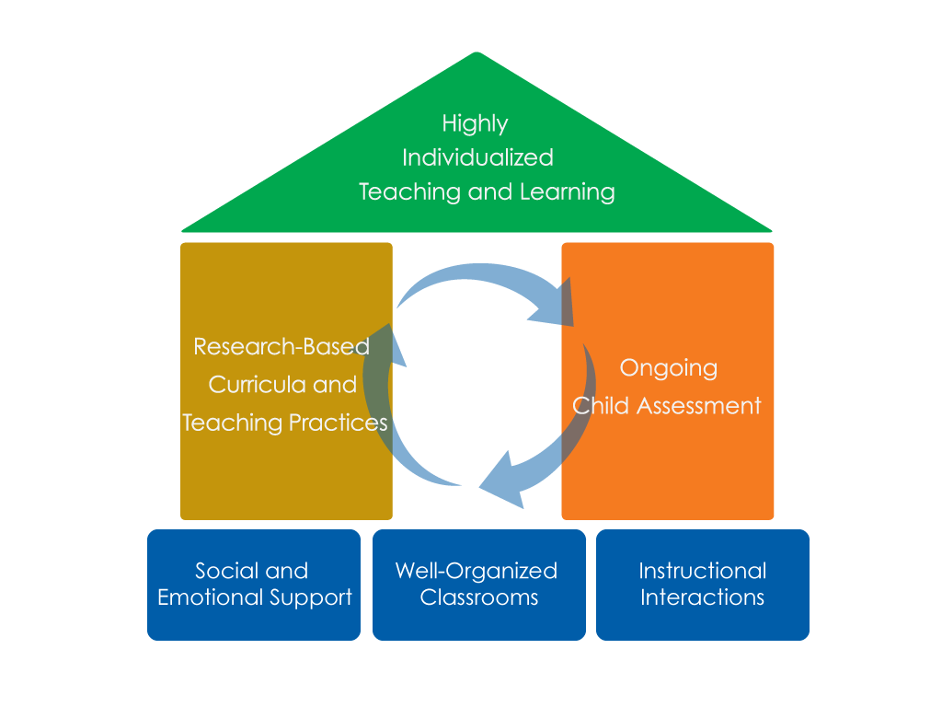
FRAMEWORK FOR EFFECTIVE PRACTICE SUPPORTING SCHOOL READINESS FOR ALL CHILDREN
FOCUS ON
FOUNDATION

Slide 3
Objectives
Provide a definition of scaffolding.
Give examples and strategies of how teachers can scaffold children’s learning.
Connect to the Head Start Child Development and Early Learning Framework.
Provide suggestions for teachers on how to improve their ability to scaffold.

Slide 4
Scaffolding Children’s Learning
What does it look like?
Teachers providing different levels of support and feedback to meet children’s individual needs, which allows them to perform at a higher level than they would independently. Teachers scaffold by:
Providing hints when children struggle to understand concepts.
Offering a range of answers for children to choose from when they need extra support answering a question.
Encouraging children to use additional resources to help them understand concepts and ideas.
What does it NOT look like?
Teachers providing children with “right” answers.

Slide 5
Provide hints
Assist children when they have difficulty understanding, answering, or completing a task by providing hints.
Teacher: Wow, I like the letter you wrote. Can you tell me the sound it makes?
Child: (says nothing)
Teacher: Well, I see the letter “y”. (And then teacher makes facial gesture for the letter “y”.)
Child: yyyy (imitating teacher)

Slide 6
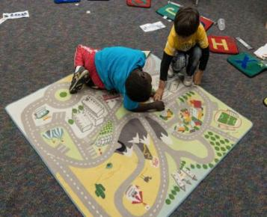
Offer a range of answers
Provide a range of answers for children to choose from when they need extra support.
Teacher: Do you remember which one of our community helpers builds roads?
Child: A policeman?
Teacher: Police officers are seen out on the streets but do they build them?
Child: (shrugs)
Teacher: Let’s look at some choices. We have a dentist, baker, teacher, or construction worker.
Conversation continues…

Slide 7
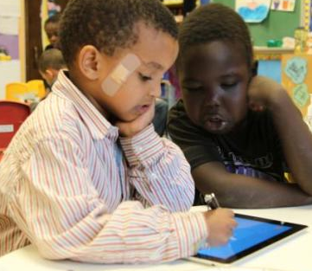
Use additional resources
Encourage children to use additional resources to help them understand concepts and ideas.
Teacher: Do you know what caterpillars turn into?
Child: I dunno.
Teacher: Why don’t we search for some information about caterpillars and see if we can figure it out.

Slide 8
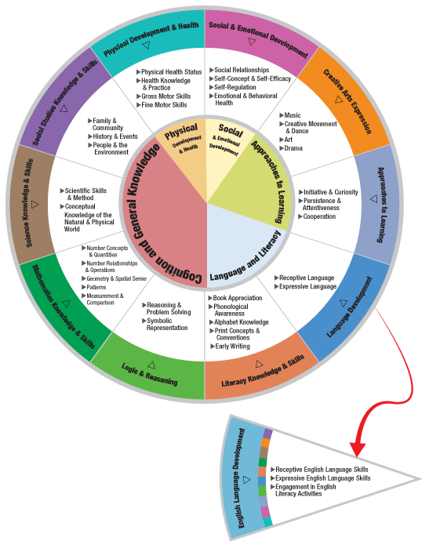
HEAD START CHILD DEVELOPMENT AND EARLY LEARNING FRAMEWORK
Scaffolding can be incorporated within many areas of the framework.
Some examples are:
Literacy Knowledge & Skills
Science Knowledge & Skills
Mathematics Knowledge & Skills
Social Studies Knowledge & Skills
Logic & Reasoning

Slide 10
IN THIS CLIP…
The teacher provides a hint as the child identifies the title of a book.
The teacher models the letter sound. She also give hints on how to make the letter “g”.
Supports children’s
Literacy Knowledge & Skills

Slide 12
IN THIS CLIP…
The teacher provides a range of answers to help a child tell something about the dolphin model. The teacher says:
It has no teeth
The belly is a different color from the rest of the body
It has a fin on the top like a shark.
Supports children’s
Science Knowledge & Skills

Slide 14
IN THIS CLIP…
The teacher provides additional resources to a child who wants to draw a picture of a dolphin. The teacher acknowledges a peer‘s suggestion and also helps the child search for a book with pictures of dolphins.
Supports children’s
Approaches To Learning

Slide 15
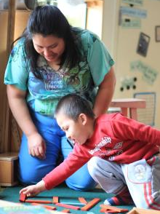
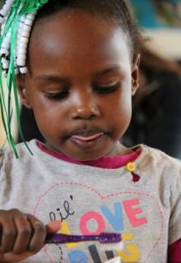
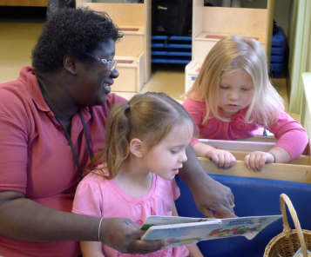
When Can I scaffold?
Teachers may scaffold children’s learning throughout the school day in many classroom activities.

Slide 16
Improving practice
Video record and review your own teaching.
Practice with a peer.
Watch a “master teacher” in action.

Slide 17
Summary
Teachers can scaffold children’s learning by:
Providing hints when children have difficulty understanding concepts.
Offering a range of answers when children need extra support.
Encouraging children to use additional resources to help them understand concepts and ideas.

Slide 18
FALL 2012

