Slide 1
Managing the Classroom: materials to support learning
FALL 2012

Slide 2
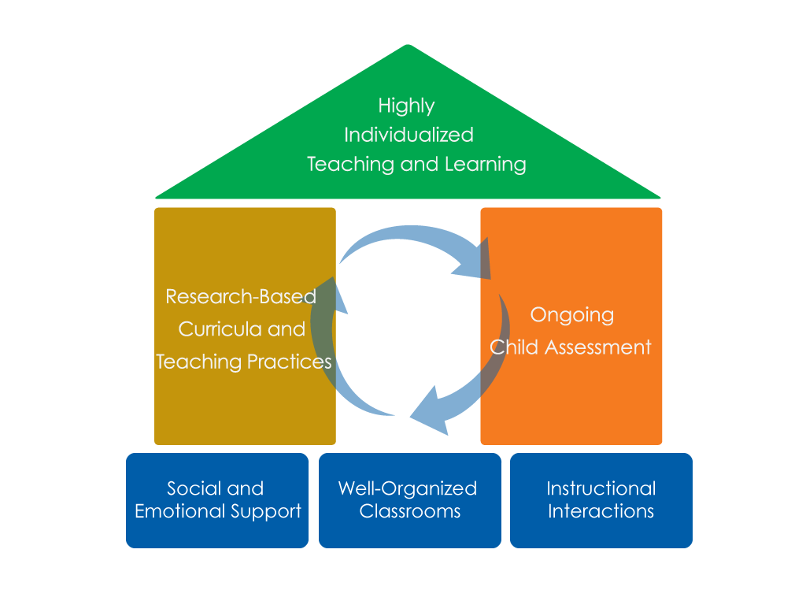
FRAMEWORK FOR EFFECTIVE PRACTICE SUPPORTING SCHOOL READINESS FOR ALL CHILDREN
FOCUS ON
FOUNDATION

Slide 3
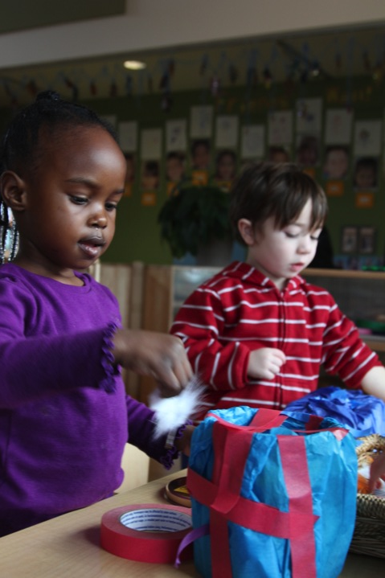
objectives:
Learn how materials support children’s learning
Learn three guidelines for selecting materials

Slide 4
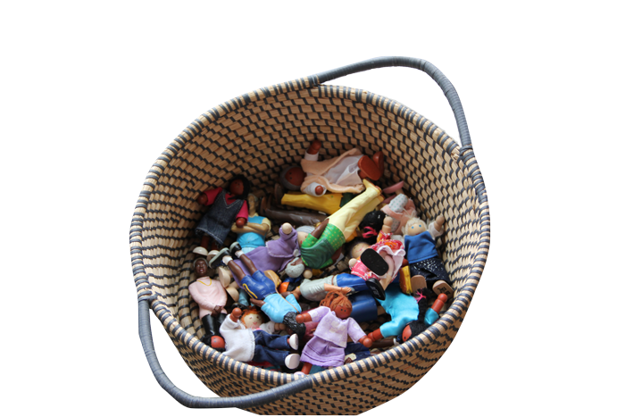
HOW MATERIALS SUPPORT CHILDREN’S LEARNING
Engage children in learning
Support social interactions
Promote independence

Slide 5
Guidelines
Do the materials promote children’s engagement in learning?
Do the materials support social interactions?
Are the materials arranged to promote independent use?
ASK YOURSELF
?

Slide 6
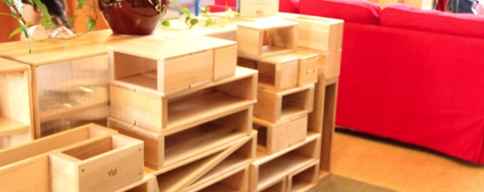
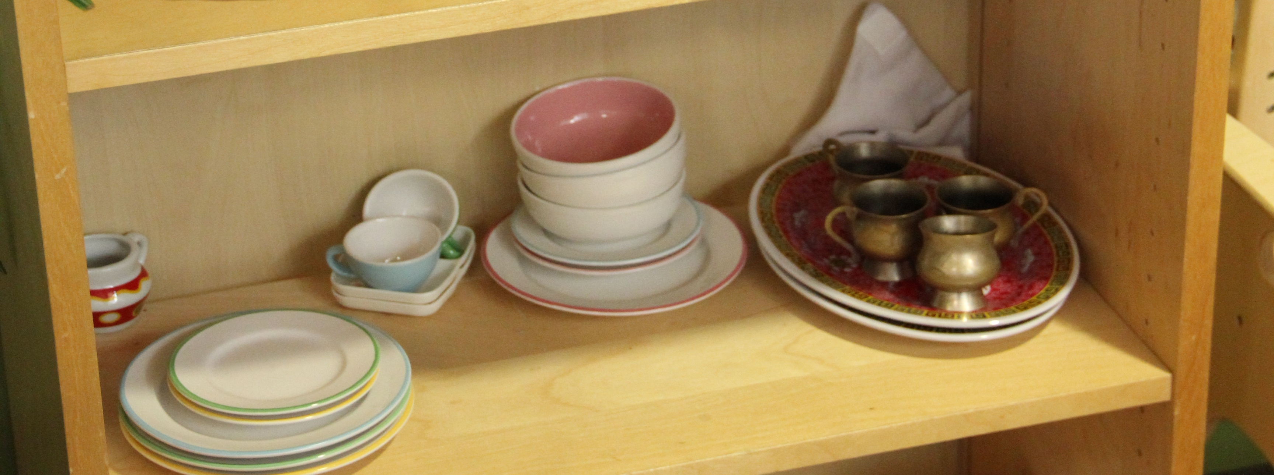
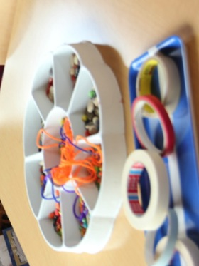
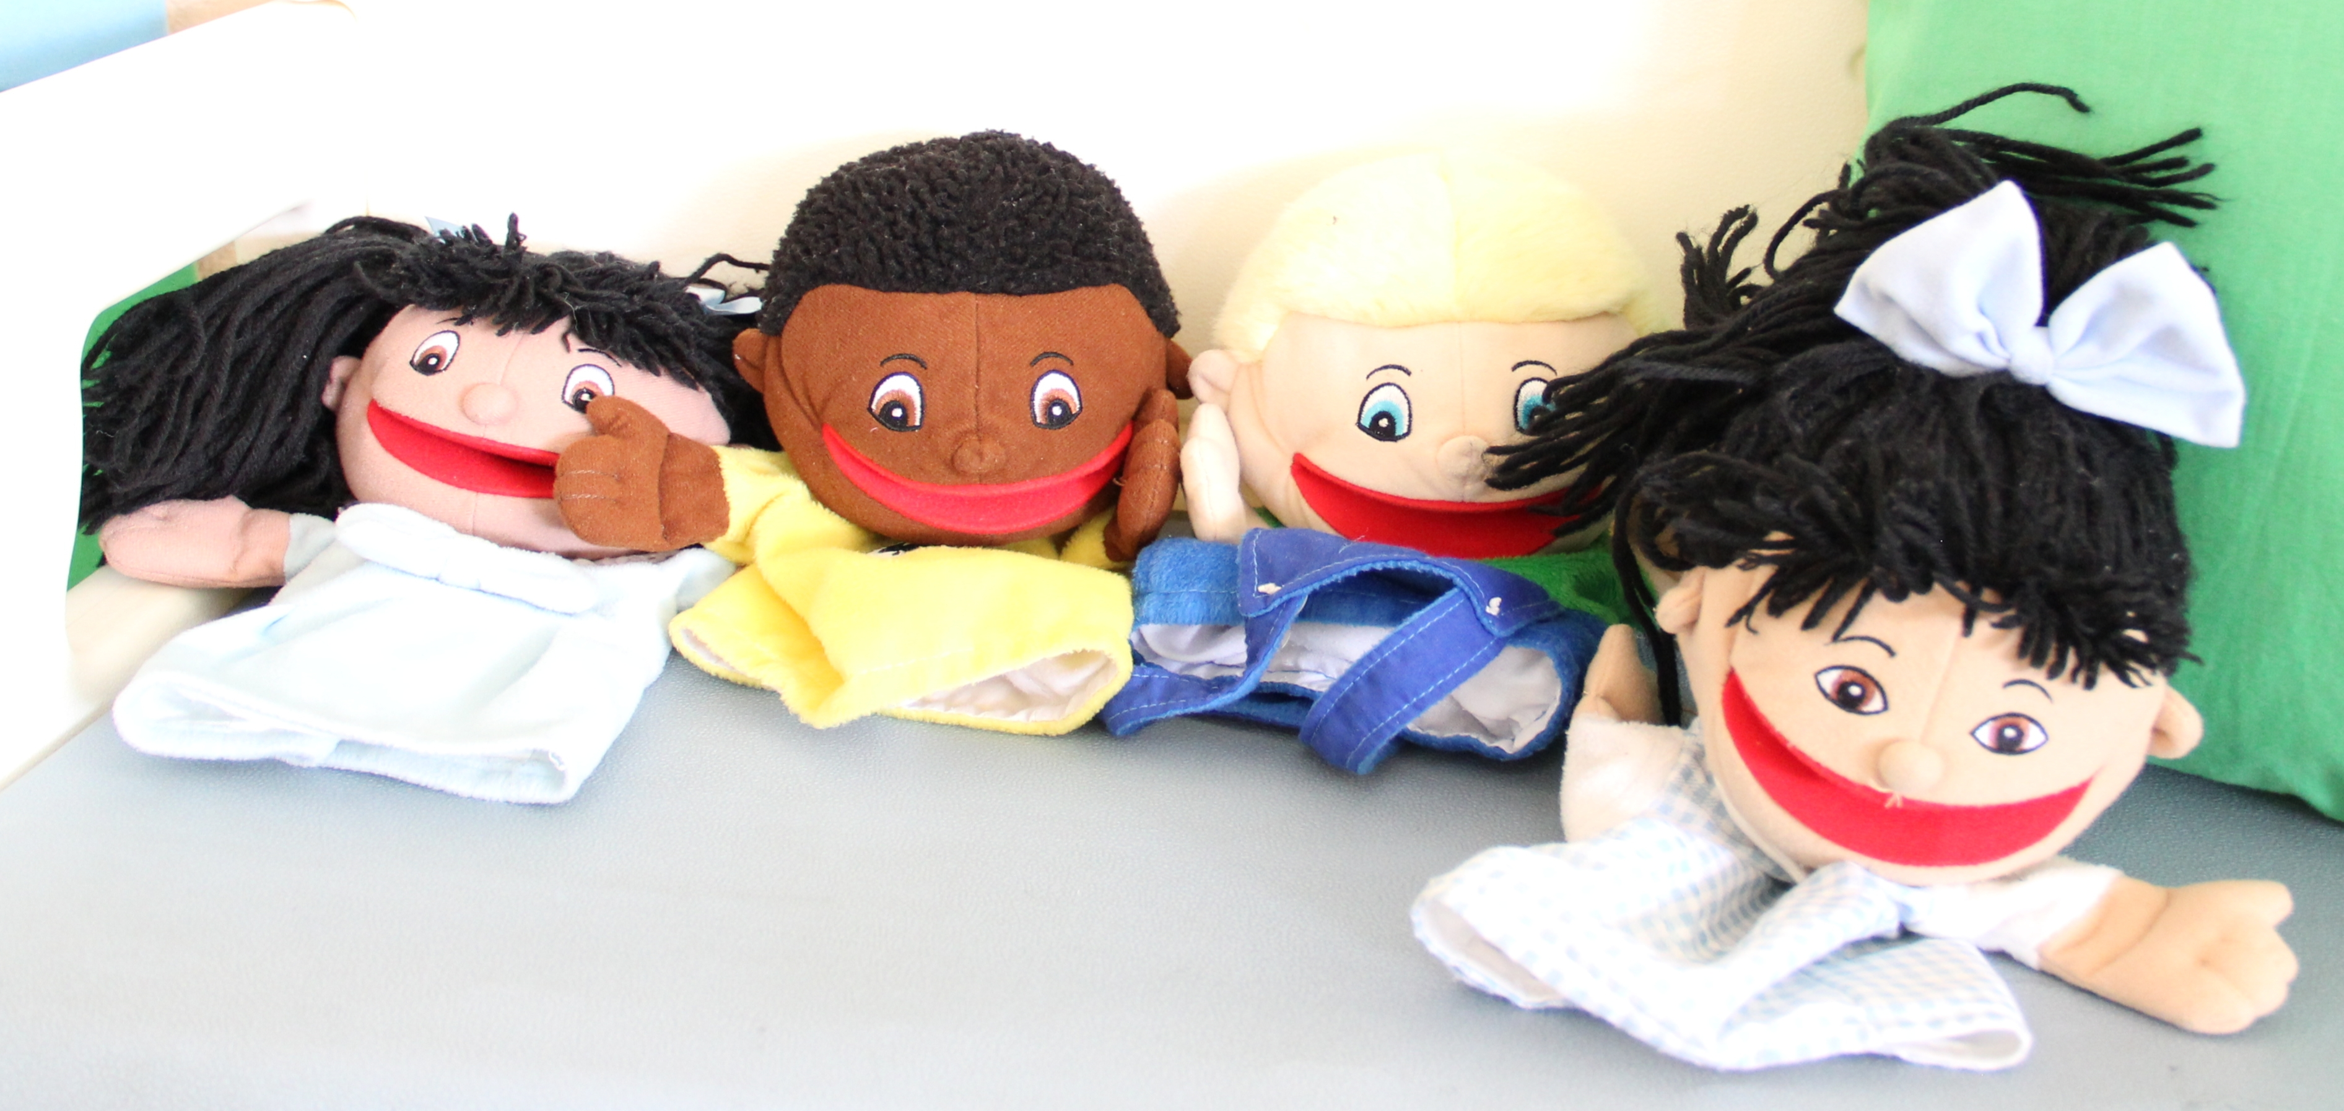
Engage children IN LEARNING: features of materials
Linked To Learning
Meaningful
Culturally Appropriate
Attractive

Slide 7
Link to learning: ENGAGING CHILDREN
You notice that children are not playing in the science area.
You decide to introduce some new materials to make the area more engaging.
What toys/materials will you introduce and why?

Slide 8
Support Social Interactions: Characteristics of children
Interests
Experiences
Home Background
Learning Goals
Abilities

Slide 9
LINK TO LEARNING: social interactions
Rosa takes dance classes and is learning to cooperate with friends.
Dao just returned from visiting family in Viet Nam for three weeks.
Sam loves to sing and wears a hearing aid.
What toys/materials can be used to support social interactions?
Why would you use them?

Slide 10
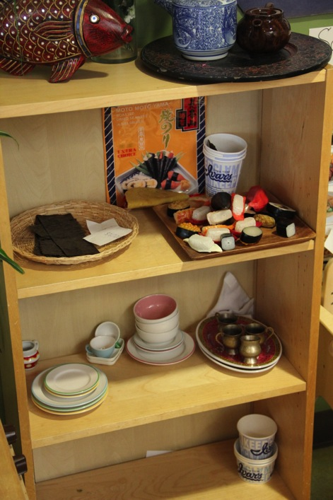
ARRANGING MATERIALS TO Promote Independence
Ordered
Accessible
Rotated
Sufficient
Durable

Slide 11
Link to learning: DISPLAYING MATERIALS
CARDBOARD TUBES
STICKS
STRING
DIRT
BOXES

Slide 12
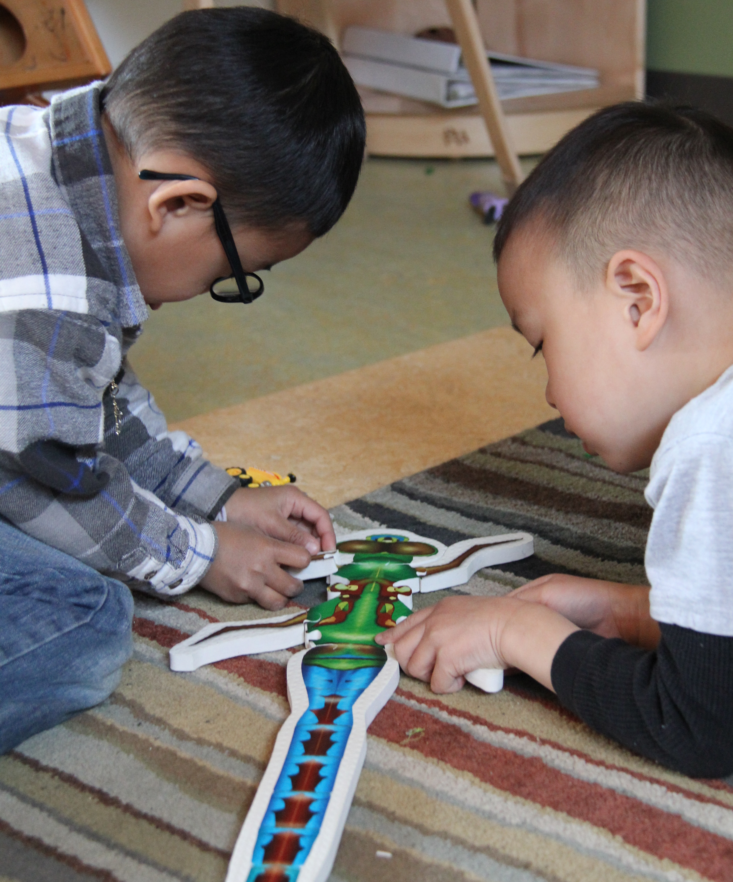
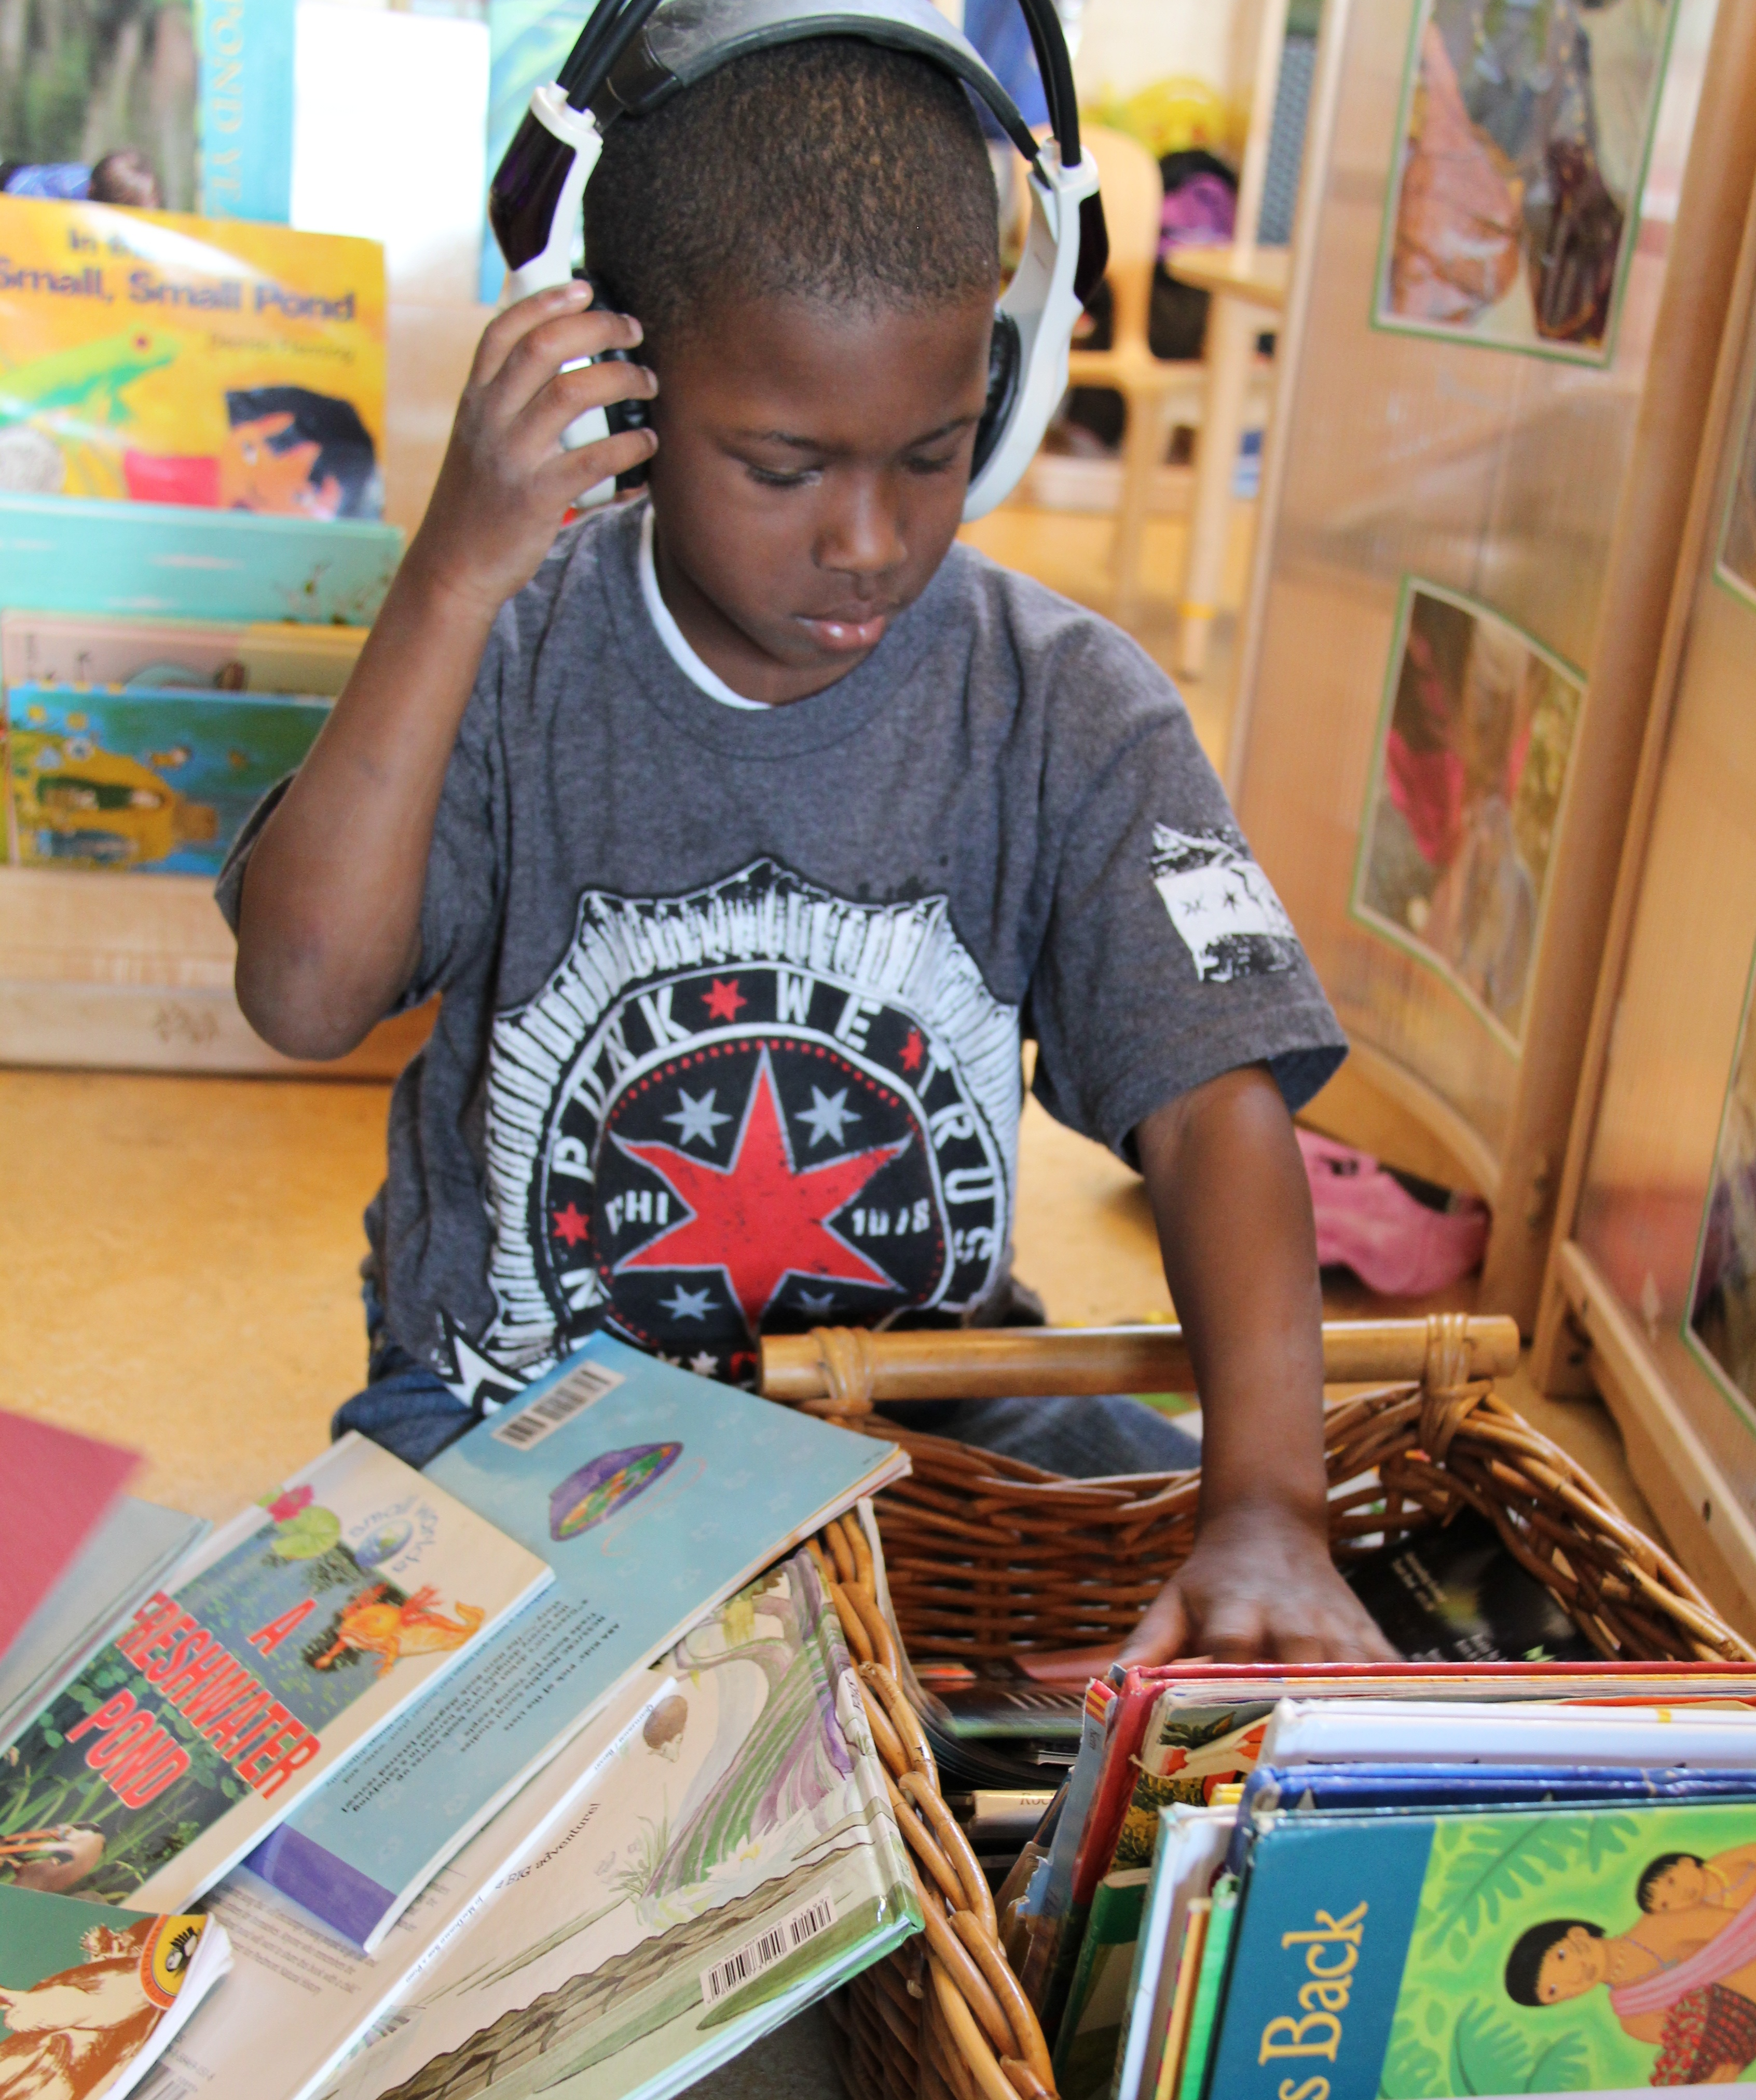
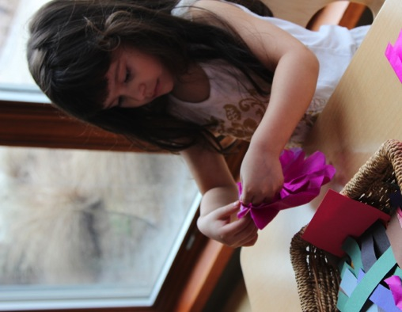
Materials support learning
Engage in learning
Support interactions
Promote independence

Slide 13
FALL 2012

