Slide 1
Notes:
Slide 1
Picture did not change

Slide 2
Every Individual is Rooted in Culture
Notes:
Slide 2
Graphic is from Multicultural Principles https://eclkc.ohs.acf.hhs.gov/sites/default/files/pdf/multicultural-principles-learning-extensions-principle-01.pdf

Slide 3
STEAM Stretches Across the ELOF Domains
Notes:
Slide 3

Slide 4
STEAM Stretches Across the ELOF Domains
Cognition (Infant/Toddler)
Exploration and Discovery
Memory
Reasoning and Problem-Solving
Cognition (Preschooler)
Mathematics Development
Scientific Reasoning
Approaches to Learning
Social and Emotional Development
Language and Communication
Perceptual Motor and Physical Development
Notes:
Slide 4

Slide 5
Red Cliff Early Childhood Center
We were always trying to integrate culture into the curriculum—the science domain, the math domain, etc. Then we realized that culture should be at the base, serving as the foundation, the building block for curriculum development. It was an amazing paradigm shift! We are now making huge gains in integrating language and culture into our early childhood programming.
—The Red Cliff Early Childhood Center
Notes:
Slide 5

Slide 6
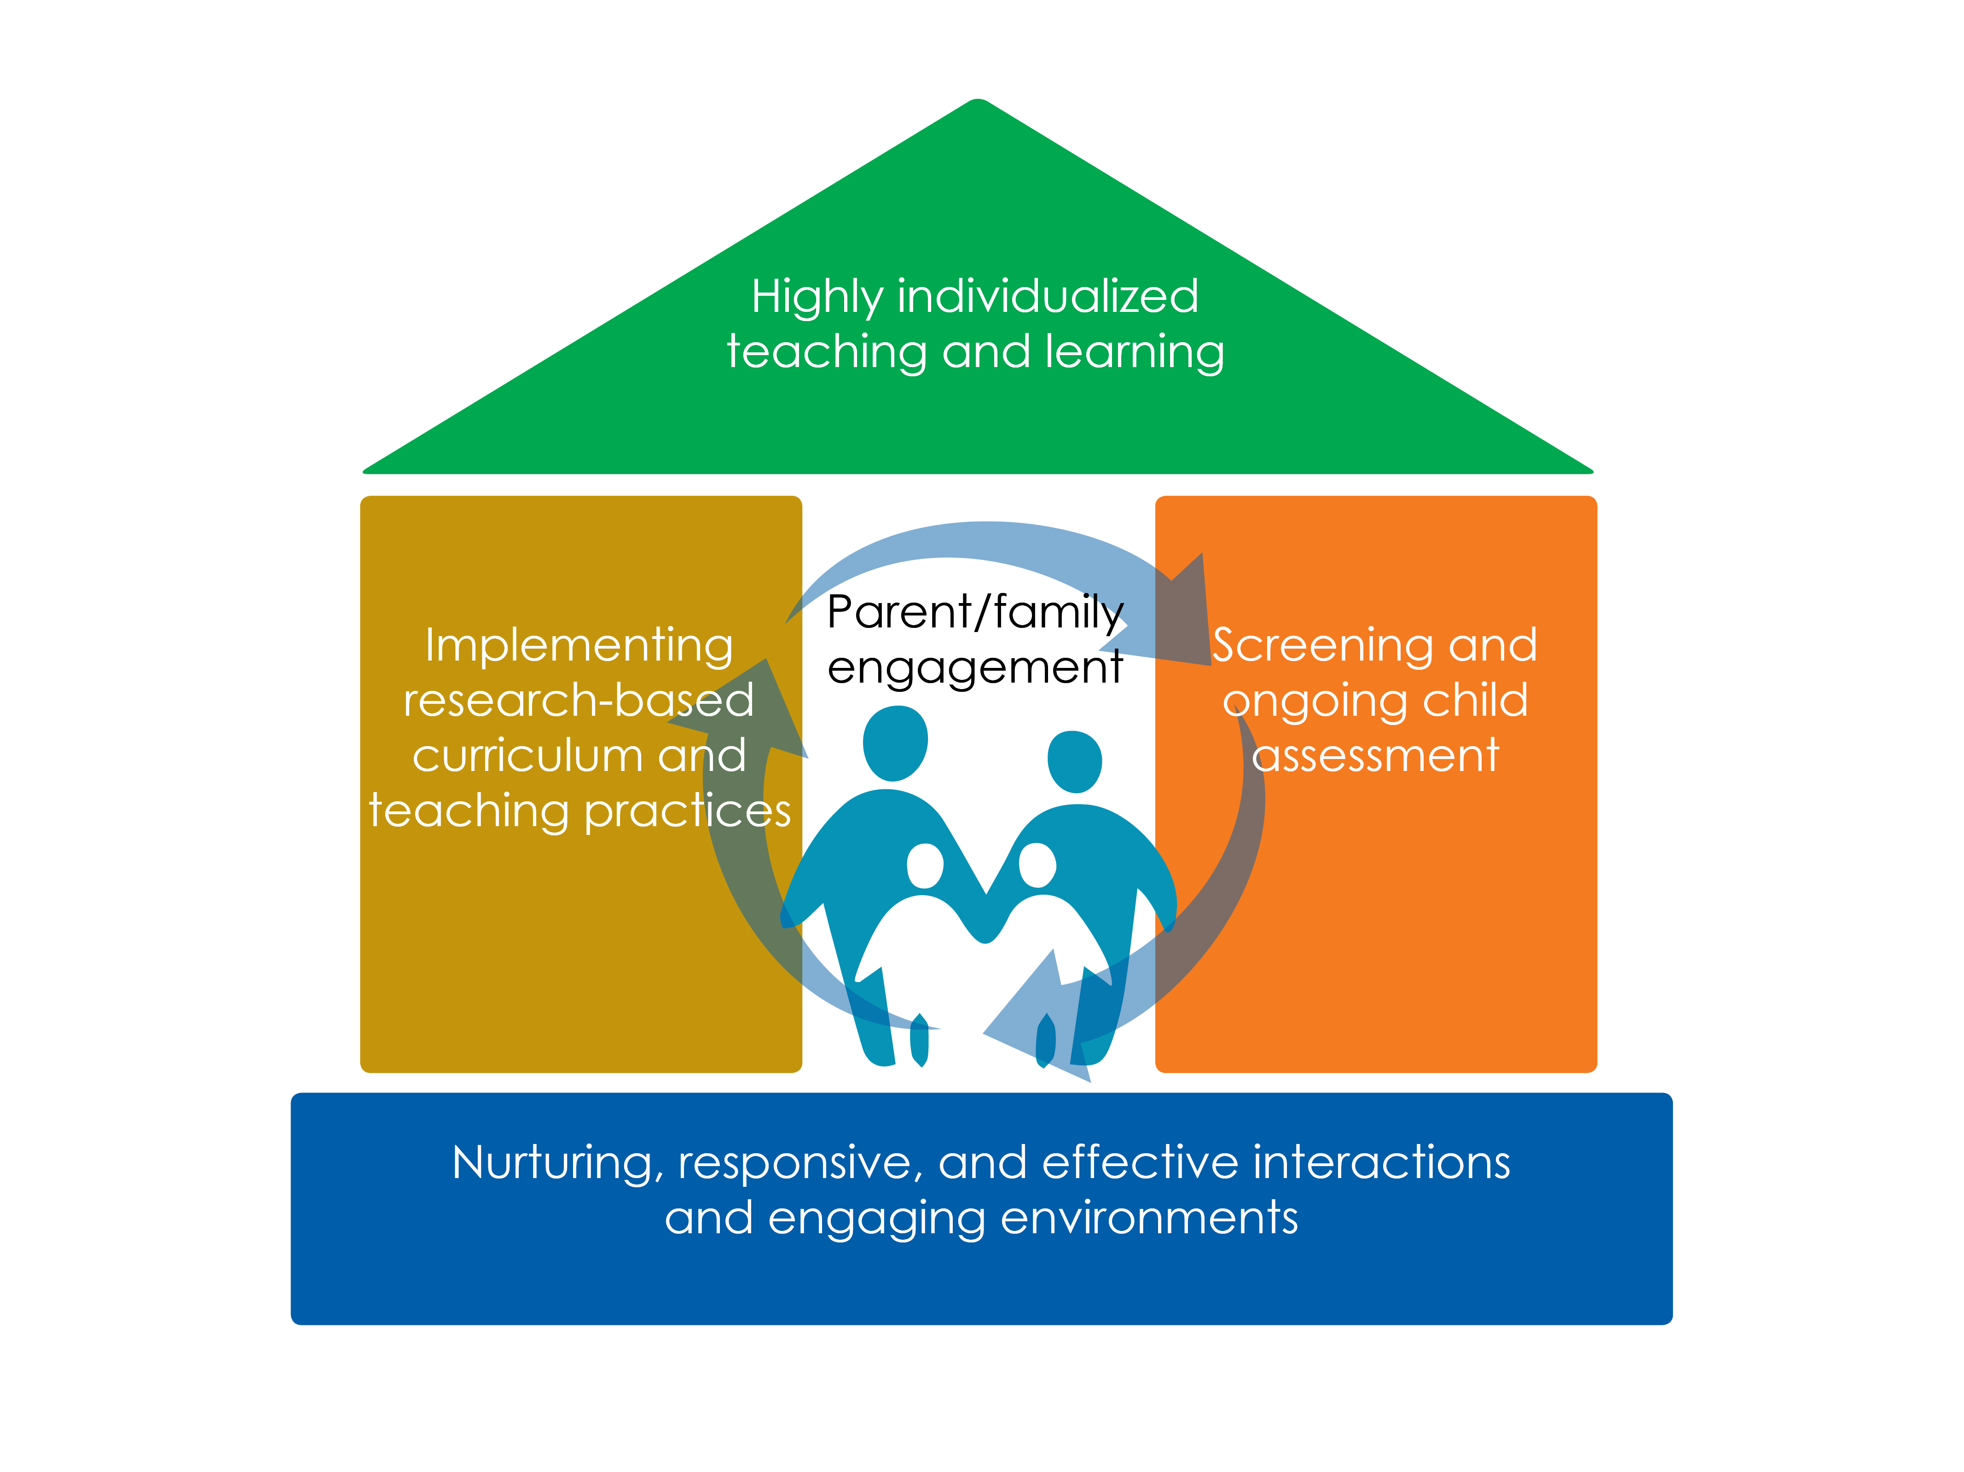
Notes:
Slide 6

Slide 7
Parent, Family, and Community Engagement
Culturally and linguistically responsive environments can only be created by engaging and partnering with families, Elders, and the community. Establishing a partnership with families and the community is crucial for children’s learning and later success in life.
Notes:
Slide 7

Slide 8
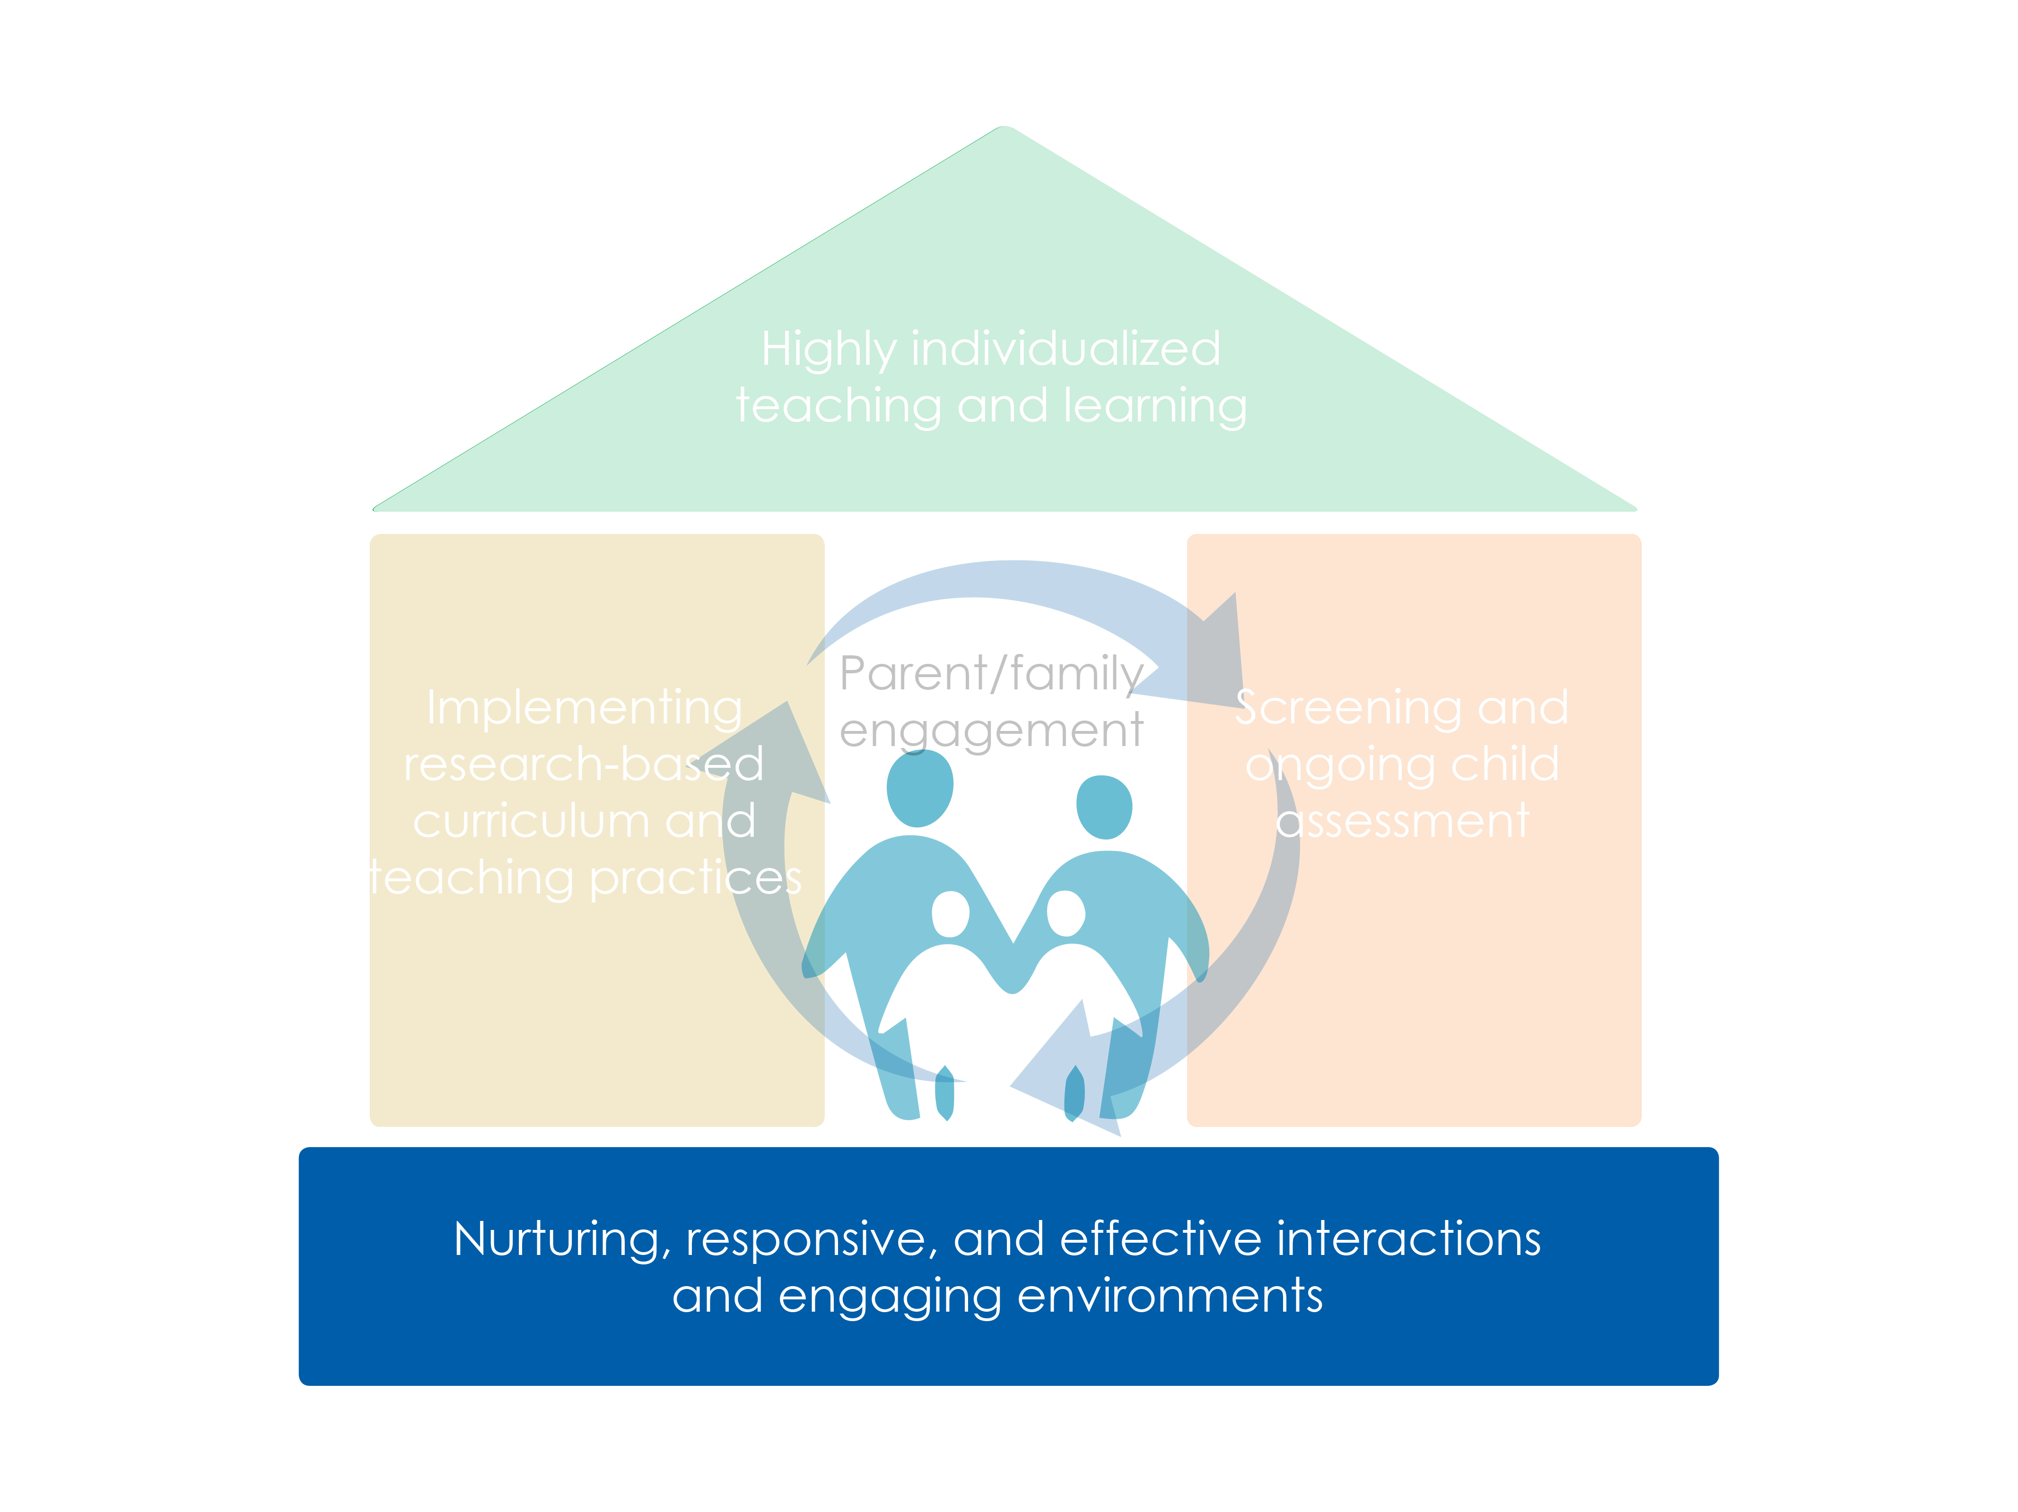
Notes:
Slide 8

Slide 9
Objectives
Identify ways infants, toddlers, and preschoolers naturally engage in inquiry, reasoning, and problem solving through everyday routines, culture, language, and learning opportunities
Describe how the STEAM components share a common approach and focus
Provide strategies to support children’s inquiry and STEAM skills in the early education setting, community, and at home
Learn to use the Steps and Introduction to Making it Work Guide to integrate culture and language in lesson plans for STEAM skills
Notes:
Slide 9

Slide 10
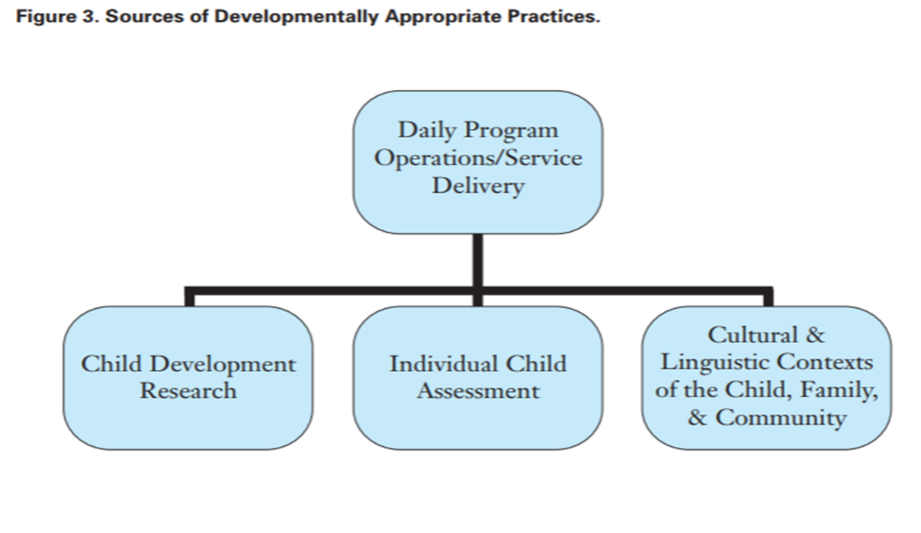
Culturally and Linguistic Responsive Practices
Sources of Developmentally Appropriate Practices
Notes:
Slide 10
Graphic from website listed on slide

Slide 11
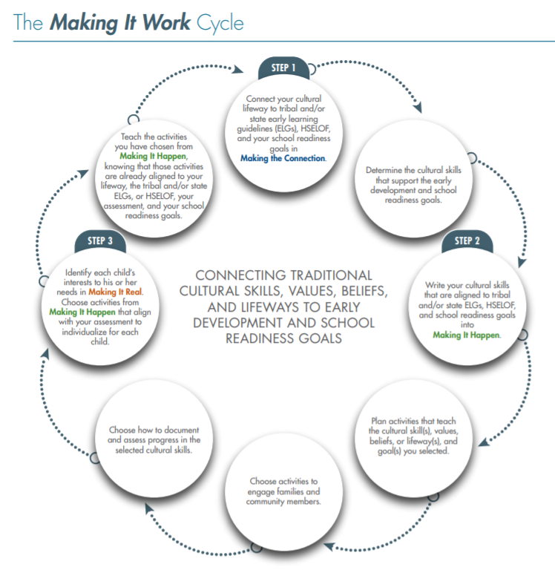
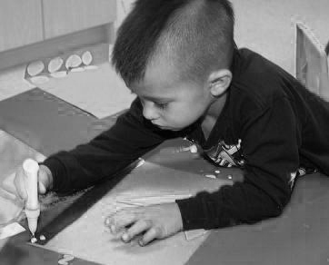
Making It Work
Without language, the canoe, paddle, water, seat, the birds you hear are different than what our ancestors experienced. If you know the language, then you know what our ancestors heard, saw, felt, and experienced.
—Zalmai “Zeke” Zahir, University of Oregon
Notes:
Slide 11
Picture did not change
Graphic from MIW

Slide 12
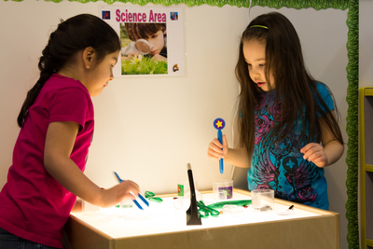
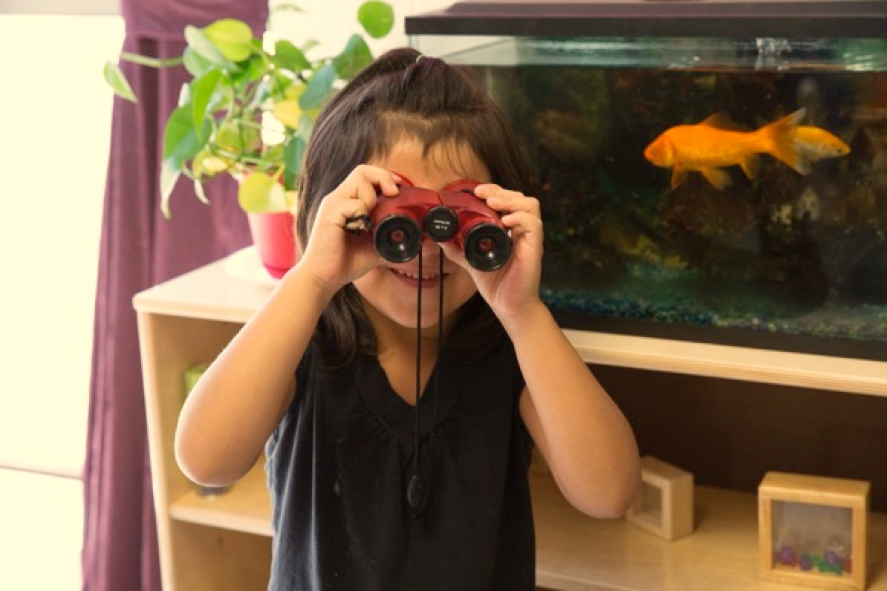
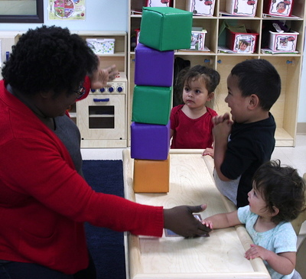
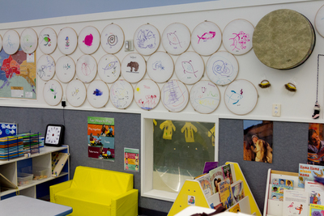
What is STEAM?
Science
Technology
Engineering
Art
Math
Notes:
Slide 12
Pictures
Science--2013-Cook-Inlet-Jason-P034_1D84D3FBE02245B48698F5D8BEF6E017
Technology-Keep same picture
Engineering--IMG_4578__899144176B204DA3BA1CD2A192C70D8A
Art-2013-Cook-Inlet-Jason_P032__85AB44BA920940A7A5F78CA74995755C.jpg
Math--FingerPlay3__C2D726F2C39D4D9B9969D02922D066CC

Slide 13
STEAM is for Everyone
STEAM is about how people explore the world, not which facts they know.
Notes:
Slide 13
Picture-girls in regalia for cover__28369C0730A247DD854D7BACE30A8761

Slide 14
STEAM is All Around

Slide 15
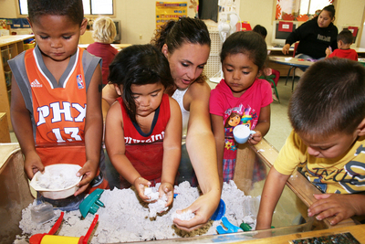
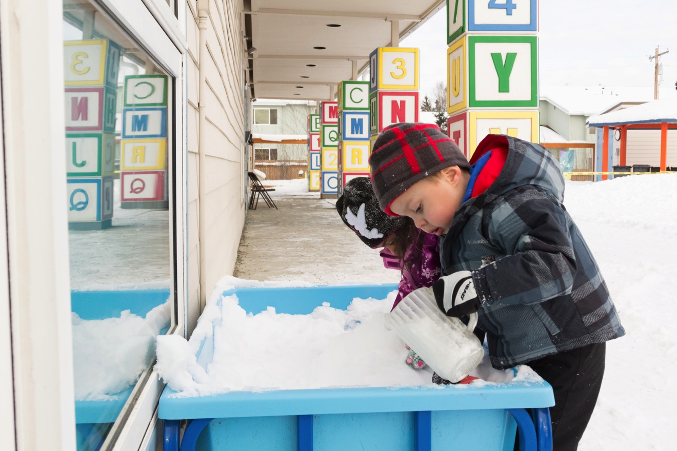
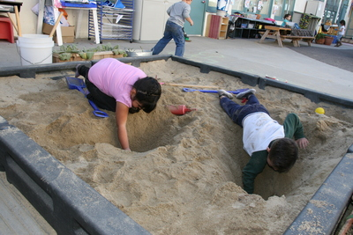
A Common Approach and Focus
STEAM Mindset
STEAM Knowledge
Language of STEAM
STEAM-Related Skills
Notes:
Slide 15
Top Left Picture--MIW-science_2959__74CB53A4D3E542619427E37E3E17F8A0
Top Right Picture—No change
Bottom Left Picture--preschool-small-group-graph-teacher_9063__D4F01338EEFF4C30B2474DF8CAC8206F
Bottom Right Picture--preschool-children-dig-hole_9075__565DD7C6EFA844AEAC08FC57D18C21B5

Slide 16
STEAM Mindset

Slide 17
Hoop Dancers from Red Cliff Bank of Lake Superior Chippewa
There is a group of teenage Hoop Dancers from the Red Cliff Band of Lake Superior Chippewa who are “stepping out” as young leaders in their community—and it all started when they were very young! In their homes and at Head Start, the girls learned the importance of their family, community, and culture. They developed social relationships while participating in the traditional, cultural music, dance, and art of their community. They learned to share, discuss, and compromise, as they developed confidence and expressed pride in their accomplishments and their culture.

Slide 18
STEAM Knowledge
Notes:
Slide 18

Slide 19
Language of STEAM
Notes:
Slide 19

Slide 20
Two-Eyed Seeing
“Two-Eyed Seeing asks us to see our strengths, the best in our ways of knowing, while also asking us to respect and celebrate our differences. Two-Eyed Seeing acknowledges the necessity of formal structure yet that it must be preamble to and receptive of new understandings and opportunities, i.e., understandings associated with ‘Spirit of the East’ which brings the ‘gift of newness, of transformation.’”
Notes:
Slide 20

Slide 21
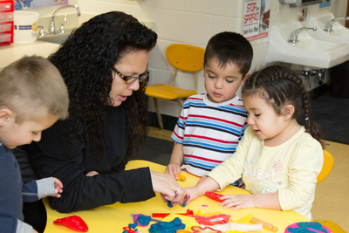
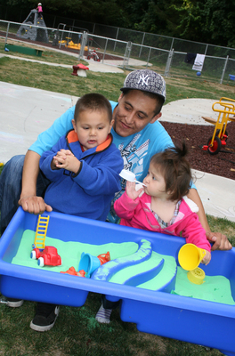
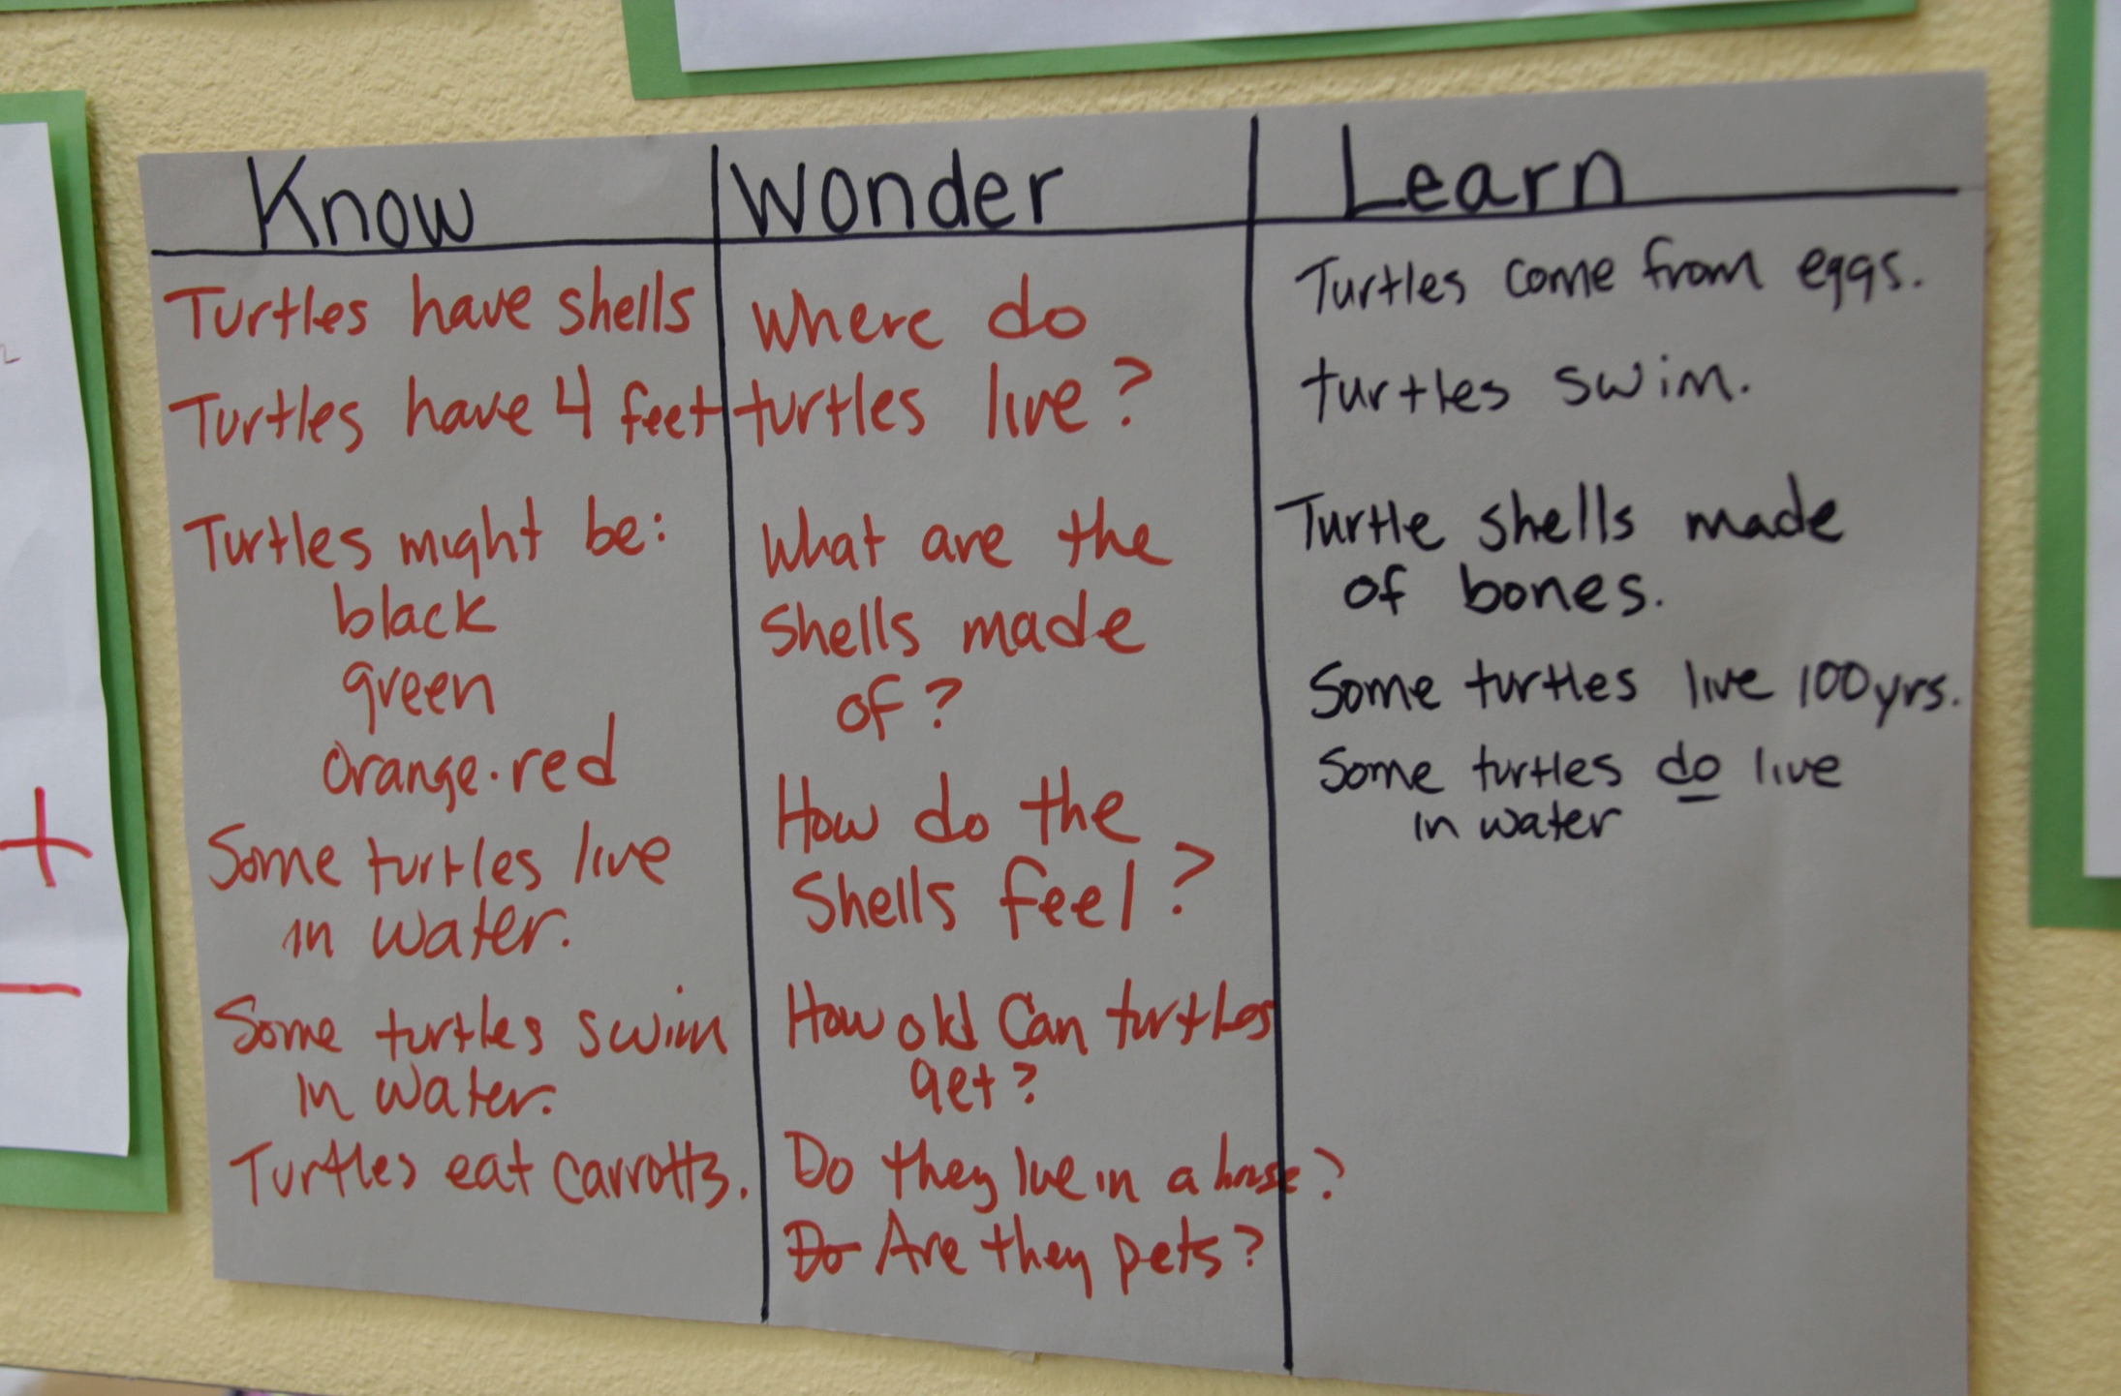
Speak The Language Of STEAM
Observe, observation
Question
Predict, prediction
Similar, different
Compare, contrast
Measure
Count
Investigate
Explore
Experiment
Test
Discover
Record
Explain
Hypothesize, hypothesis, guess
Notes:
Slide 21

Slide 22
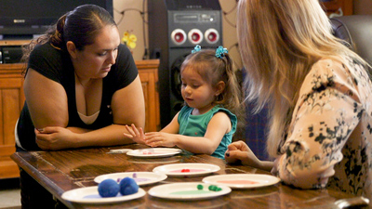
STEAM-Related Skills
Notes:
Slide 22

Slide 23
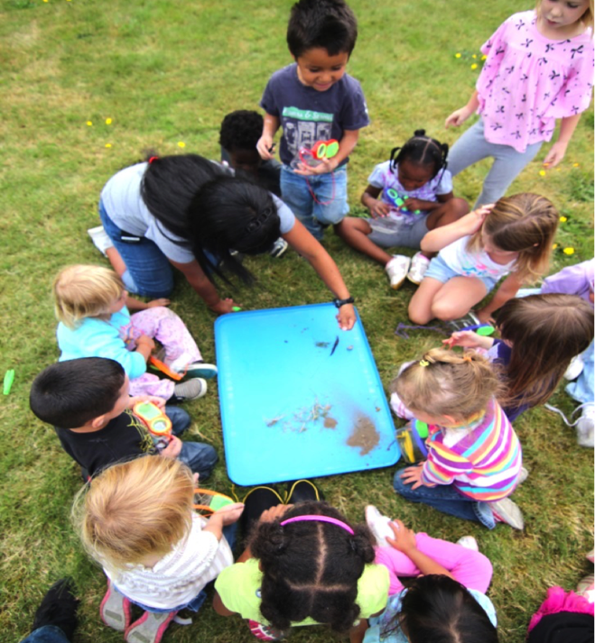
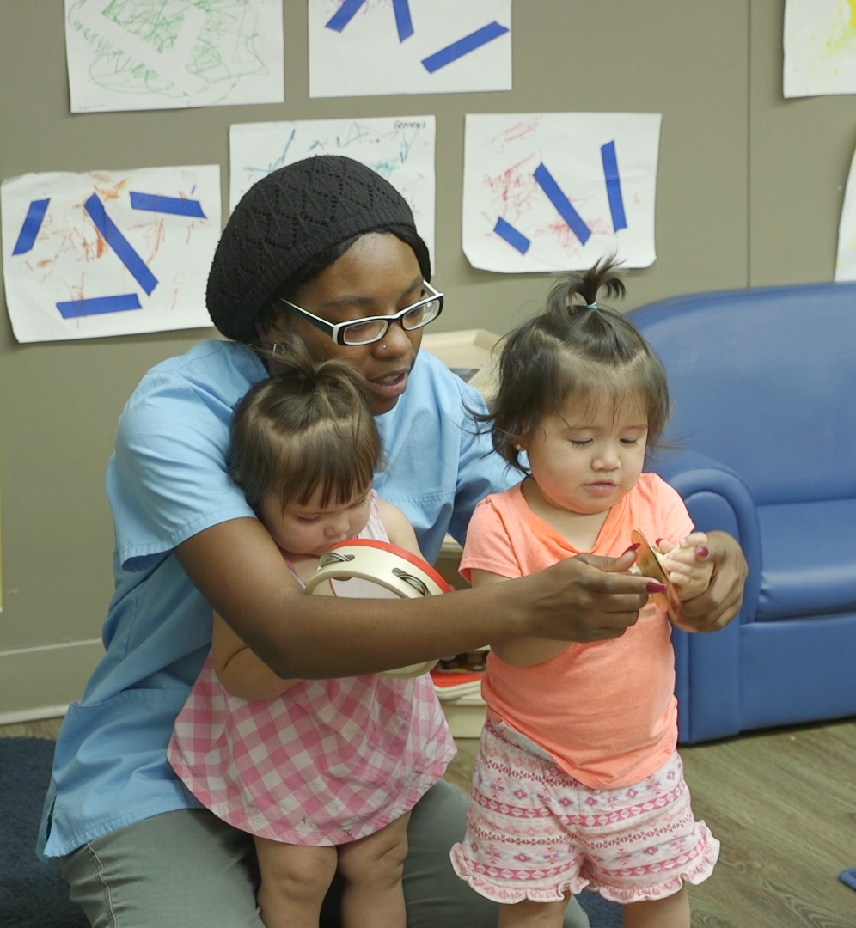
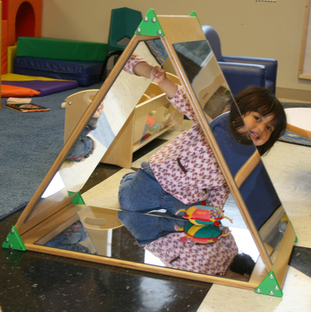
How We Can Support STEAM Learning
Engaging
Environments
Nurturing, Responsive, & Effective Interactions
Learning Experiences/Activities
Notes:
Slide 23

Slide 24
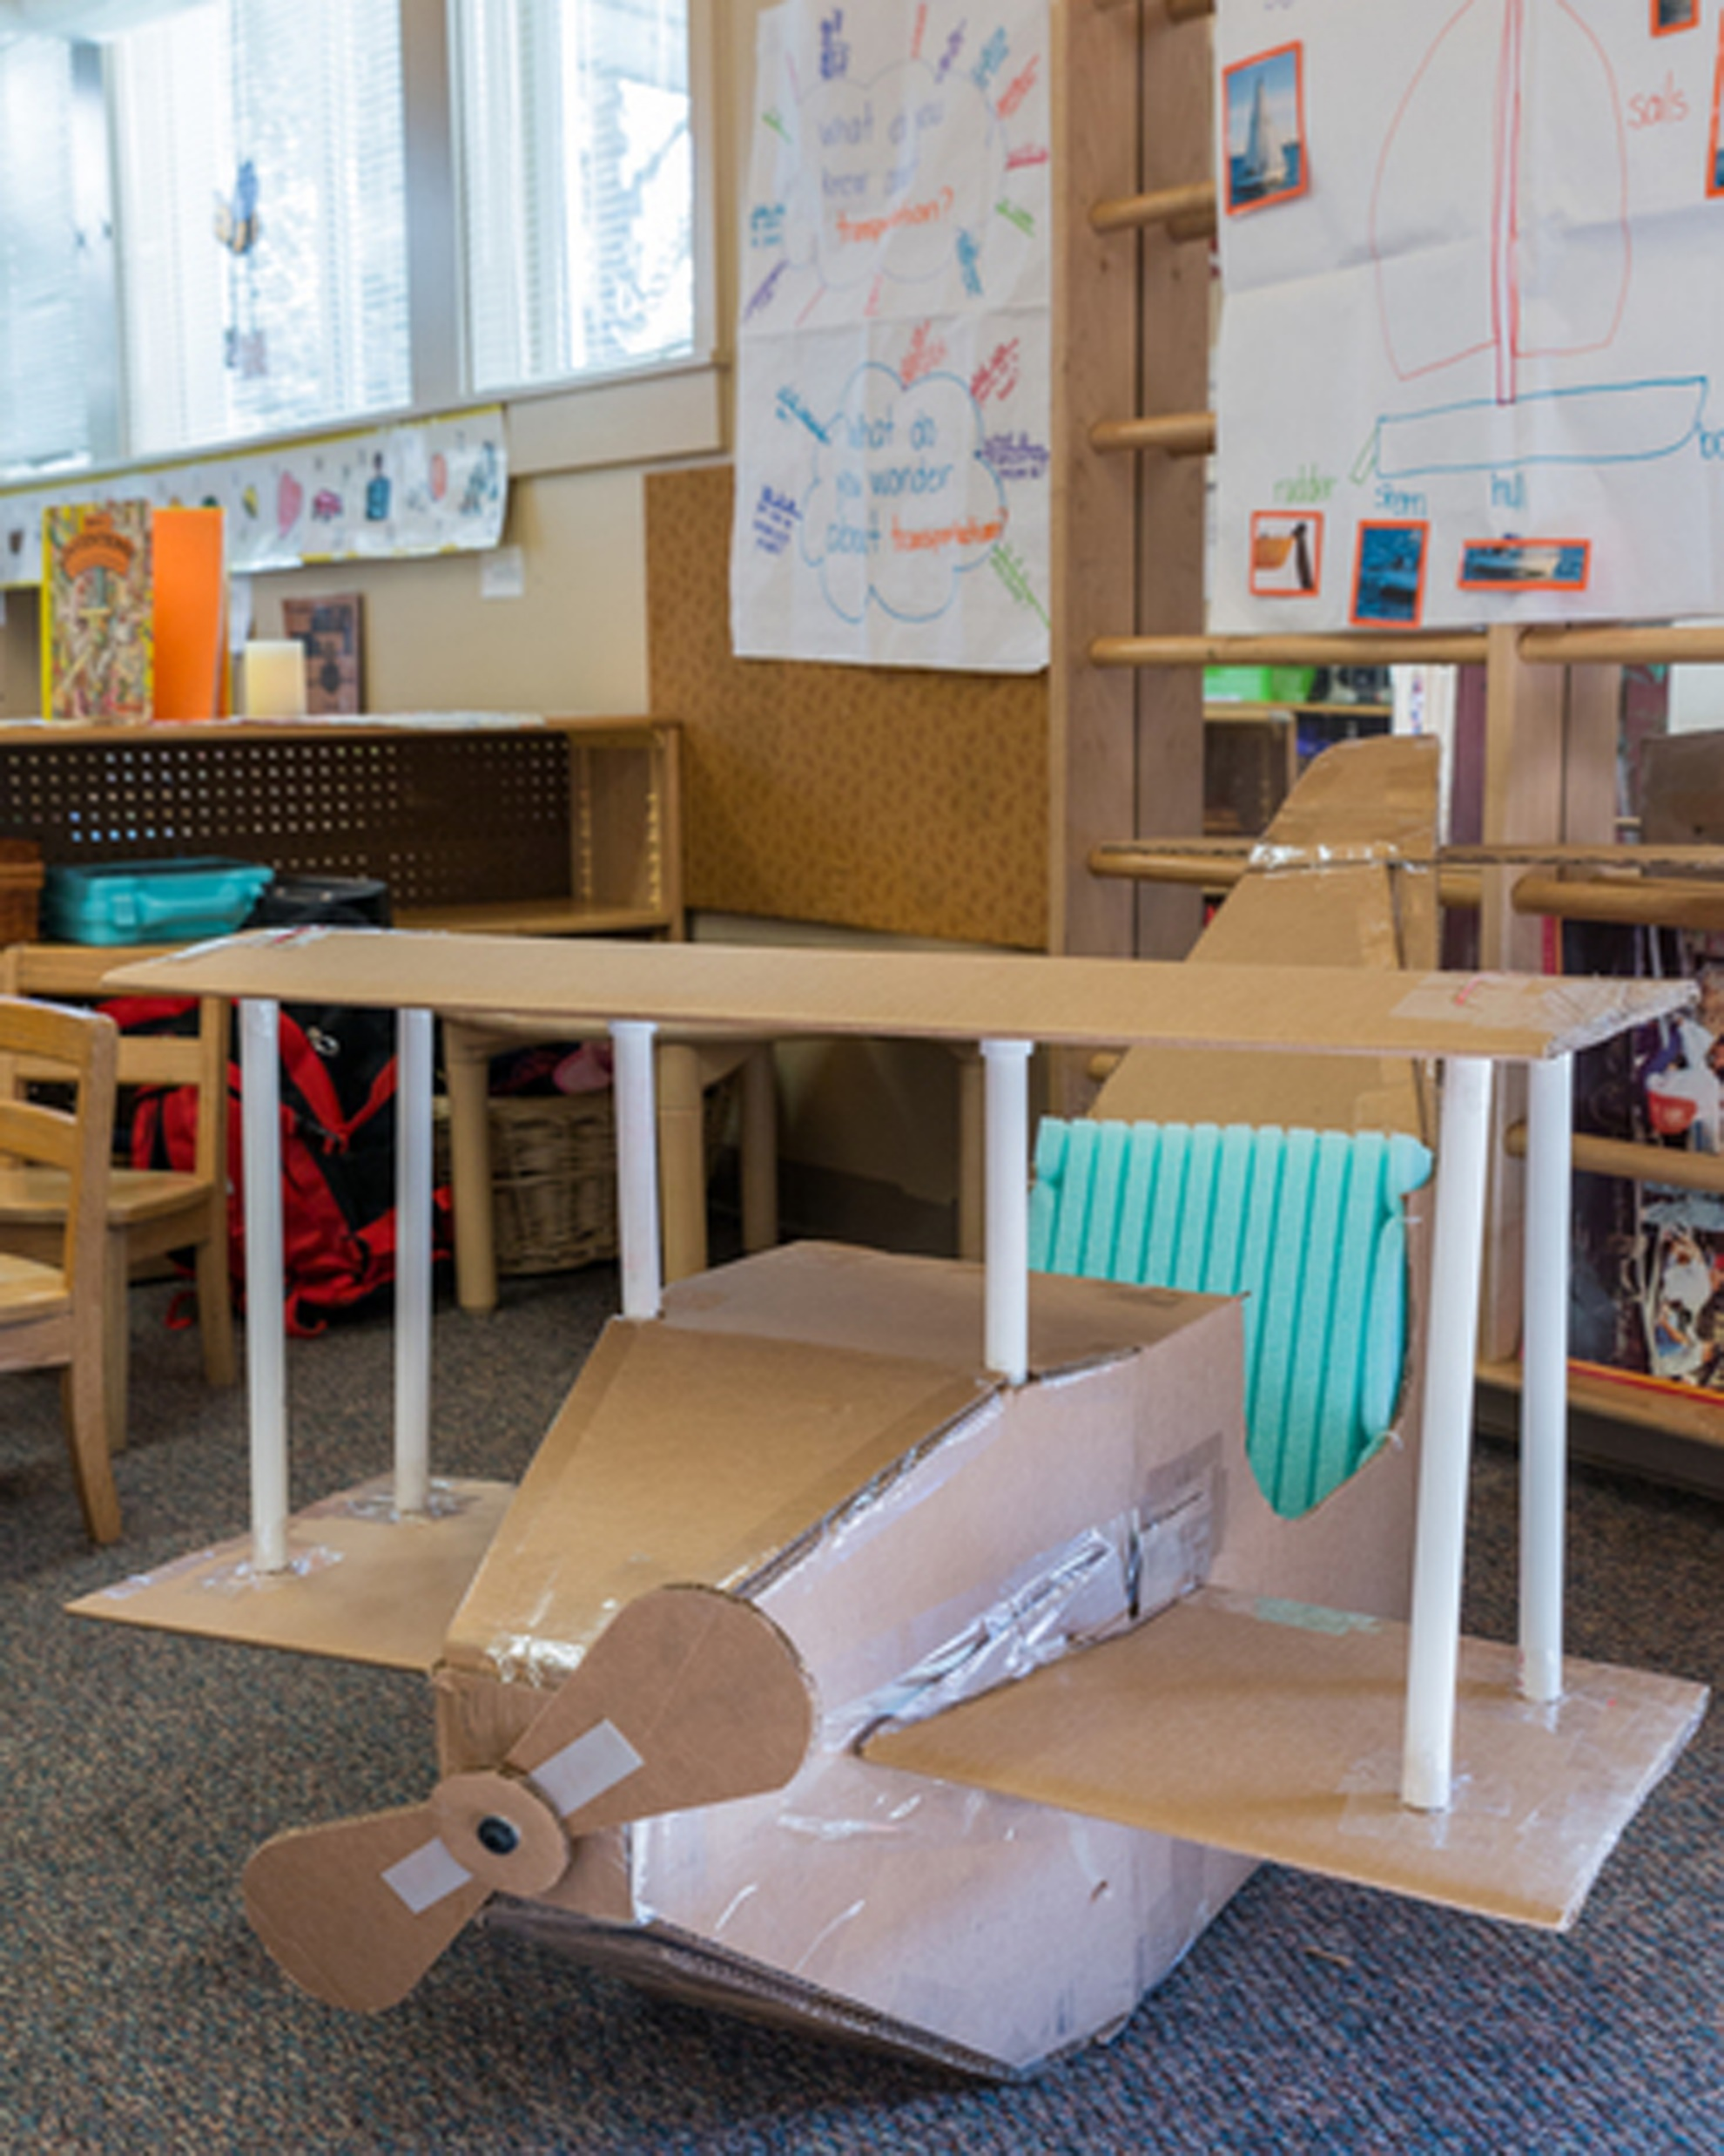
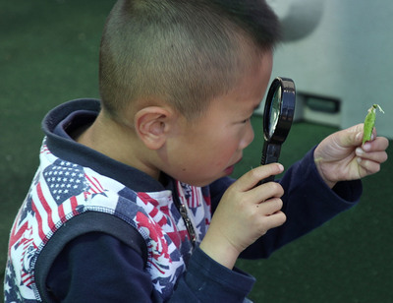
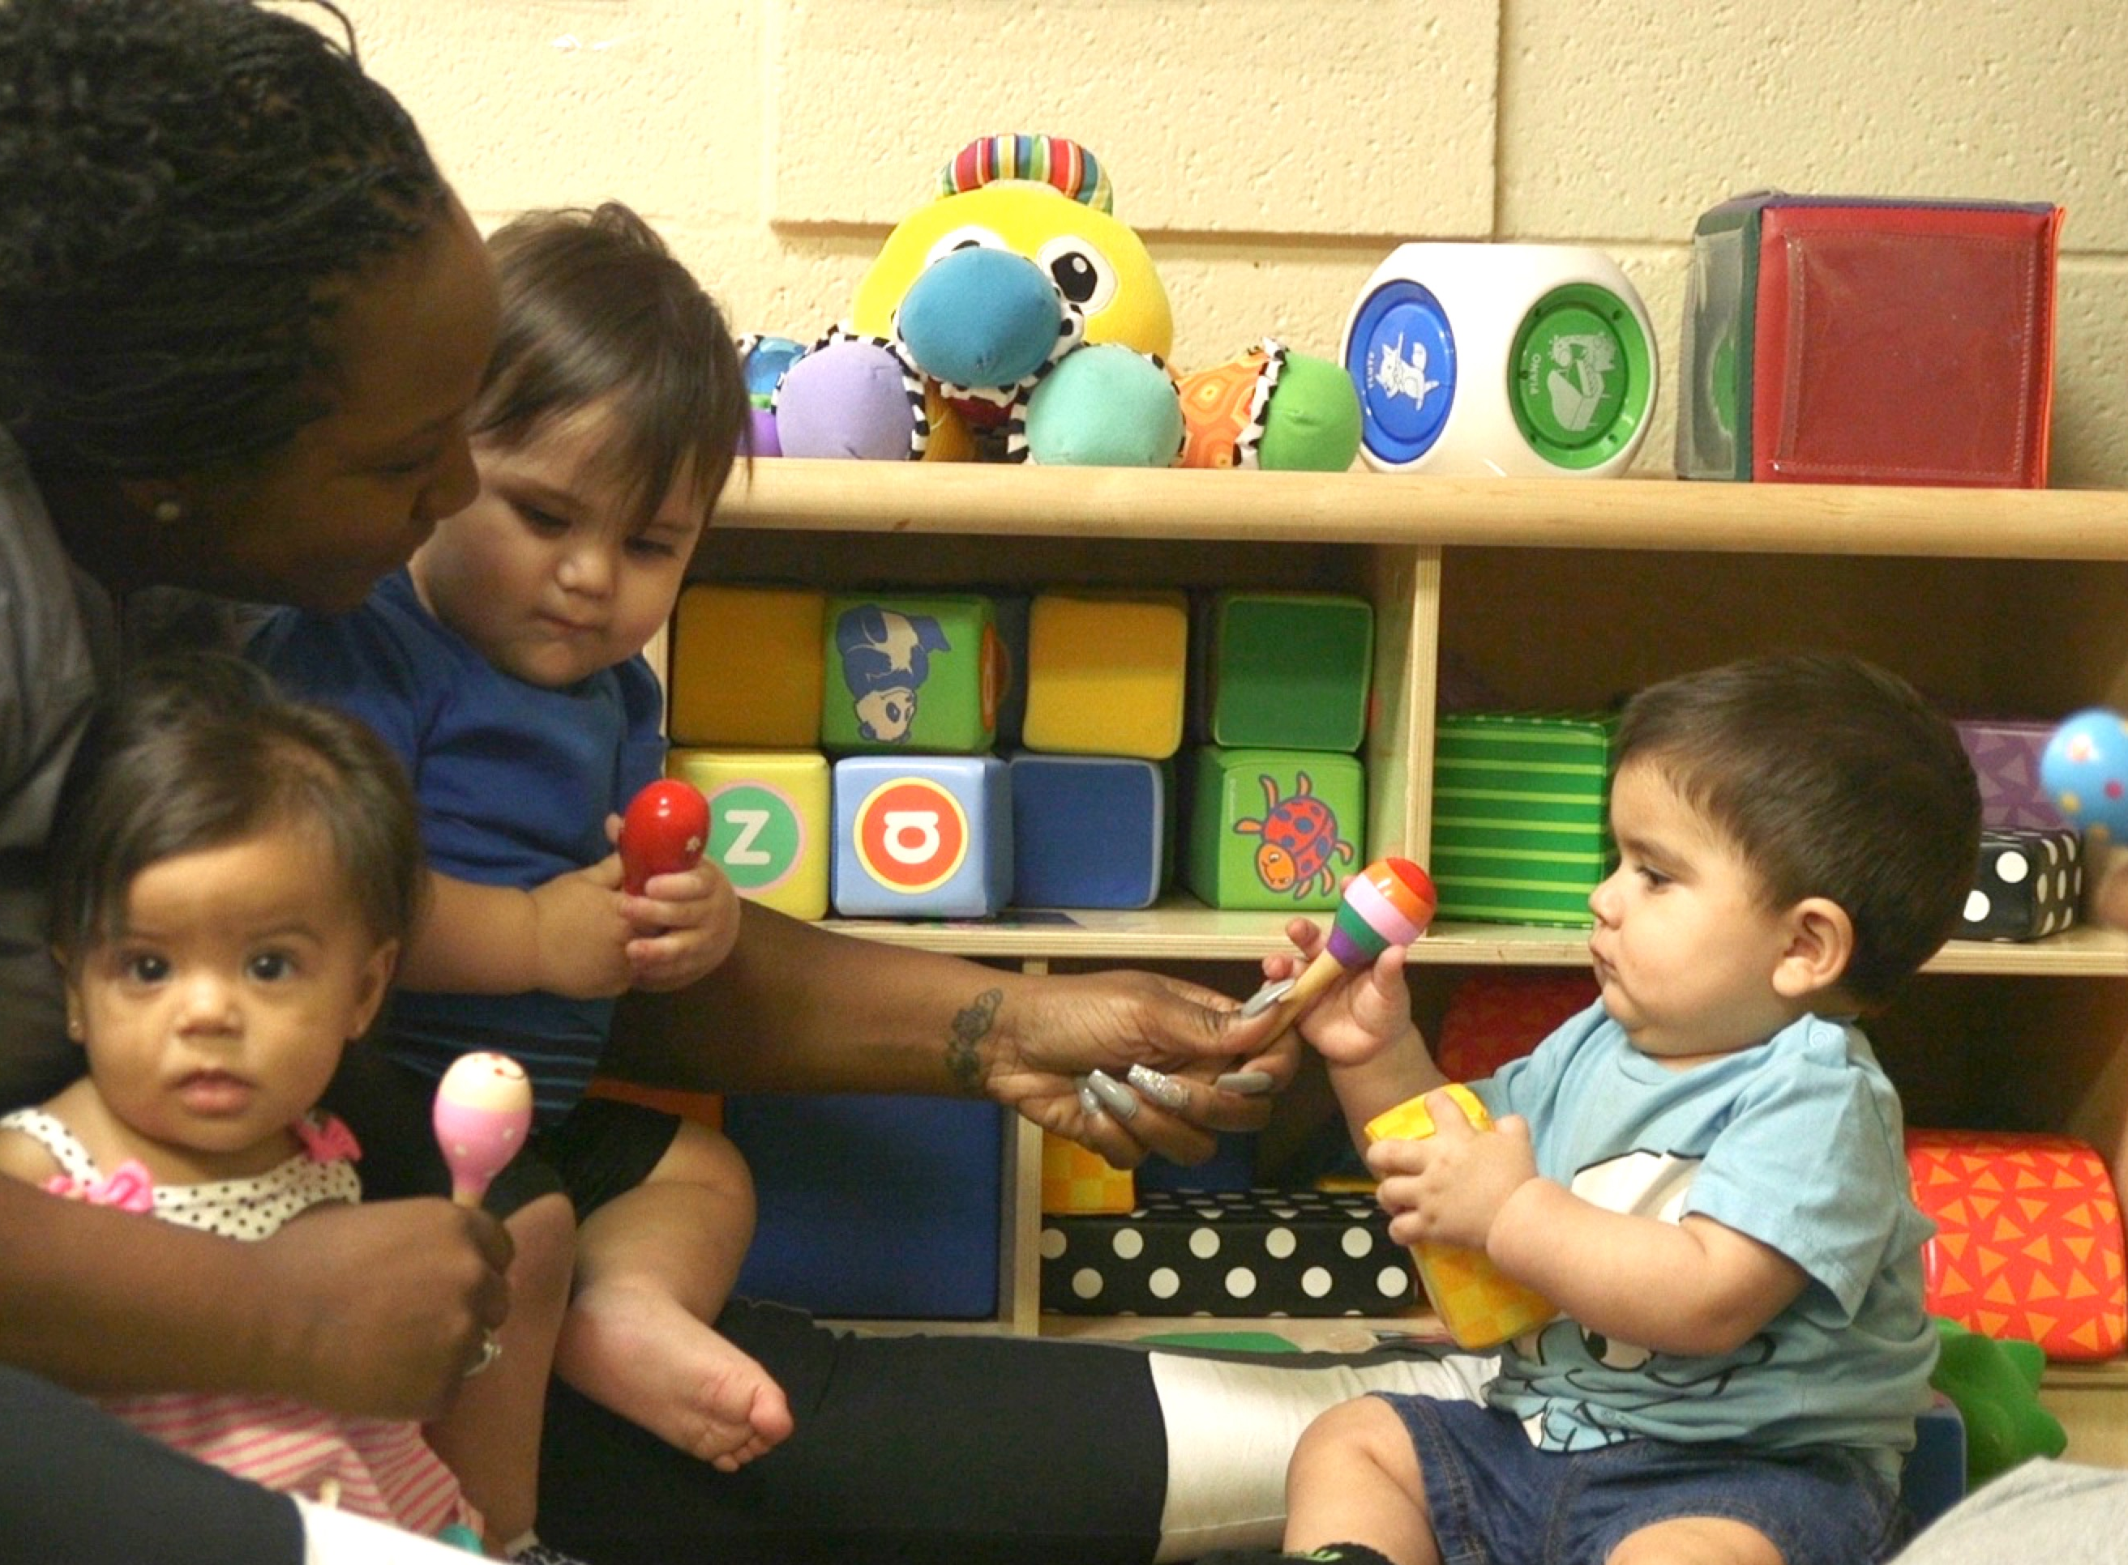
Engaging Environments
Provide open-ended materials
Engage the senses
Consider children’s developmental levels
Use a variety of materials
Pay attention to children’s interests
Arrange materials so they are accessible
Notes:
Slide 25

Slide 25
Nurturing, Responsive, & Effective Interactions
Notes:
Slide 26

Slide 26
Learning Experiences/Activities

Slide 27
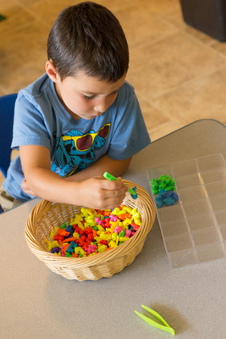
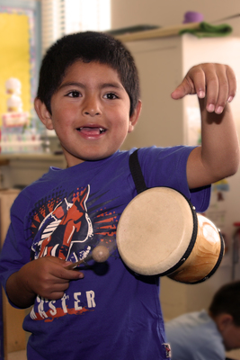
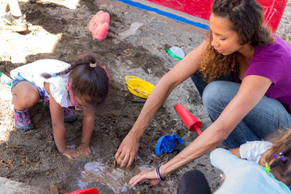
Learning Activity: STEAM in Everyday Experiences & Activities
Notes:
Slide 28

Slide 28
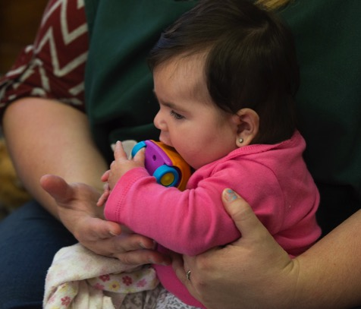
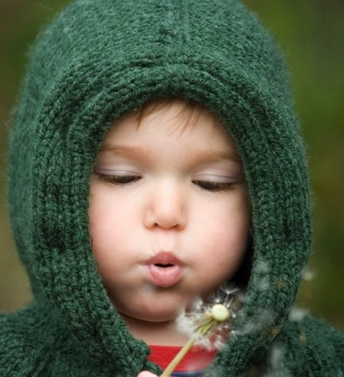
Review
Notes:
Slide 31

